Slide 1
Contrafact Detection Analysis
25-July-2022

Slide 2
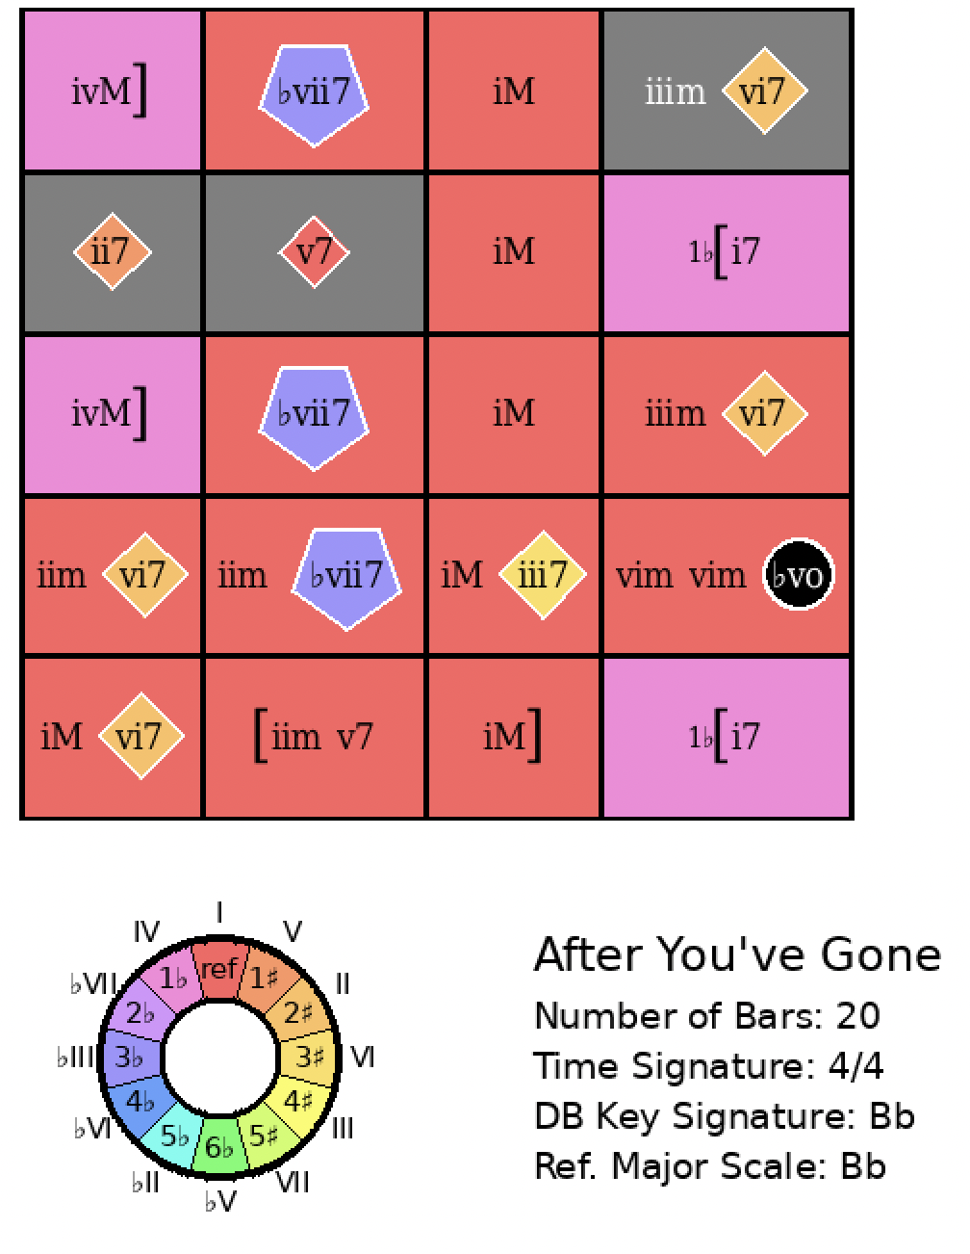
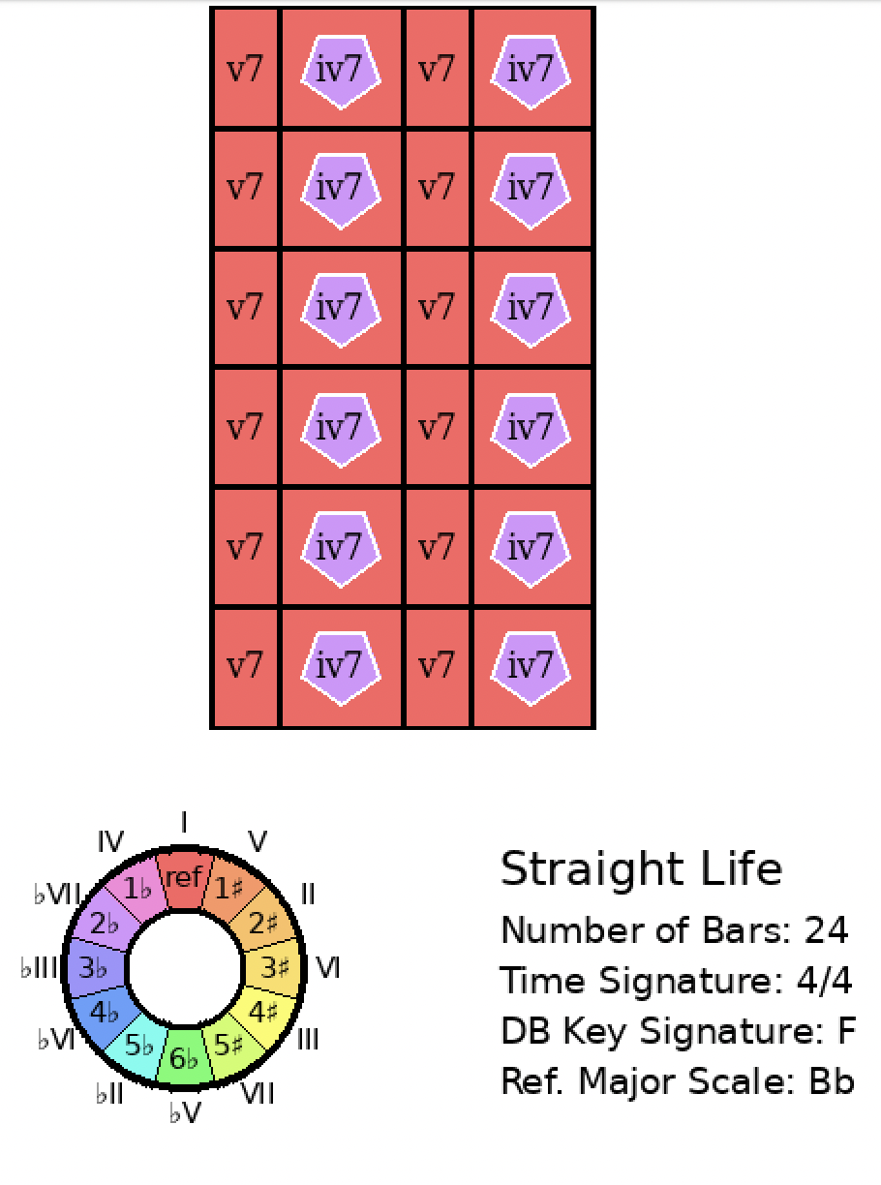
After You’ve Gone
Rank = 2350, Area = 57.47

Slide 3
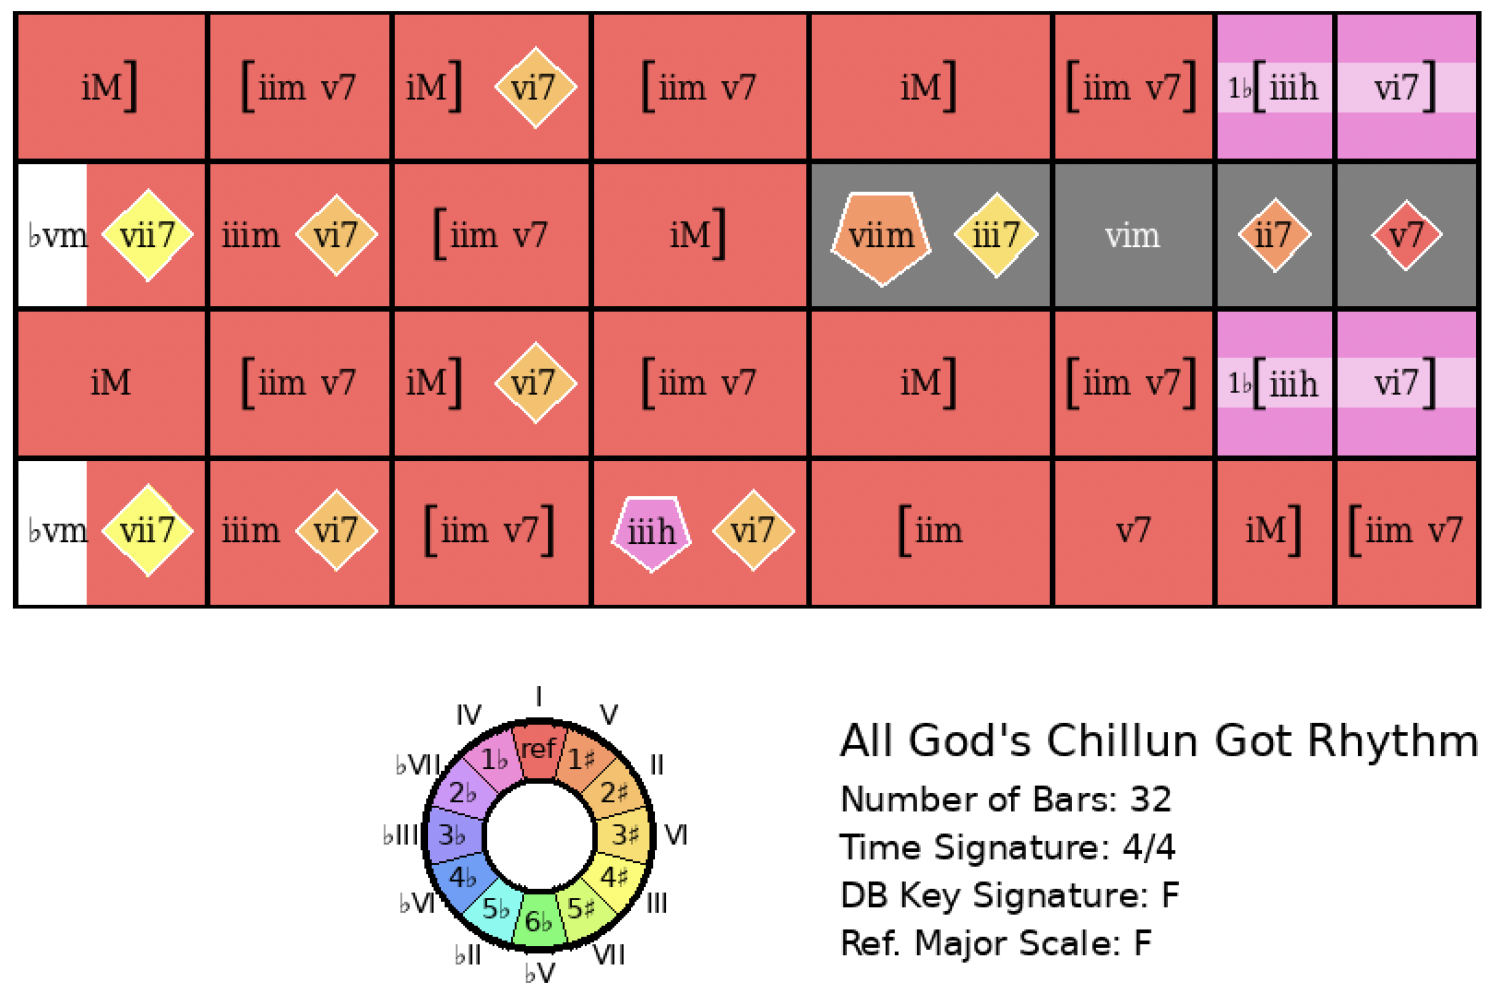
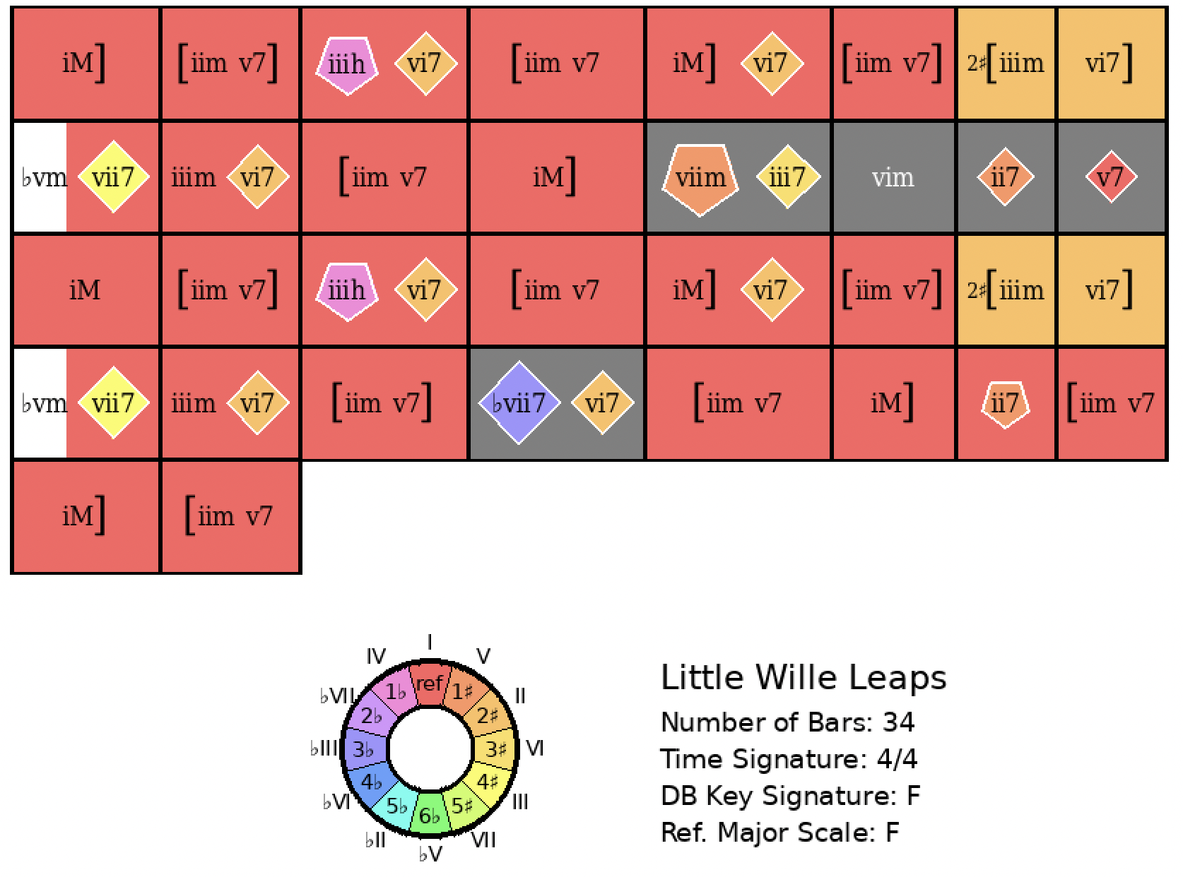
All God’s Chillun Have Rhythm
Rank = 1, Area = 12.55

Slide 4
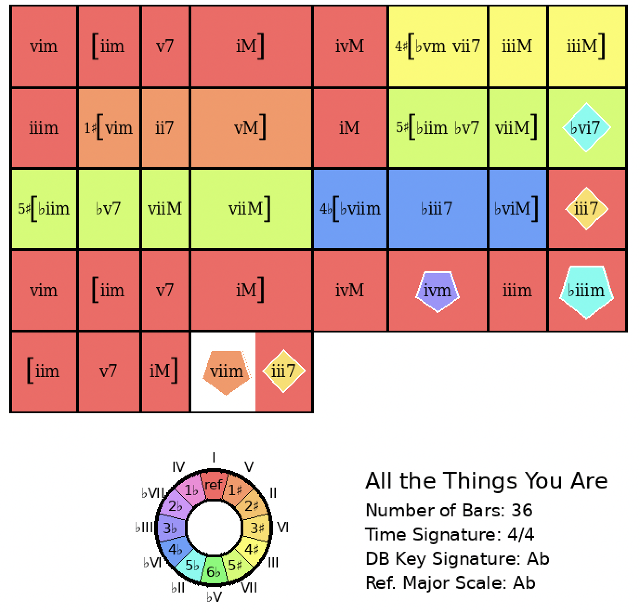
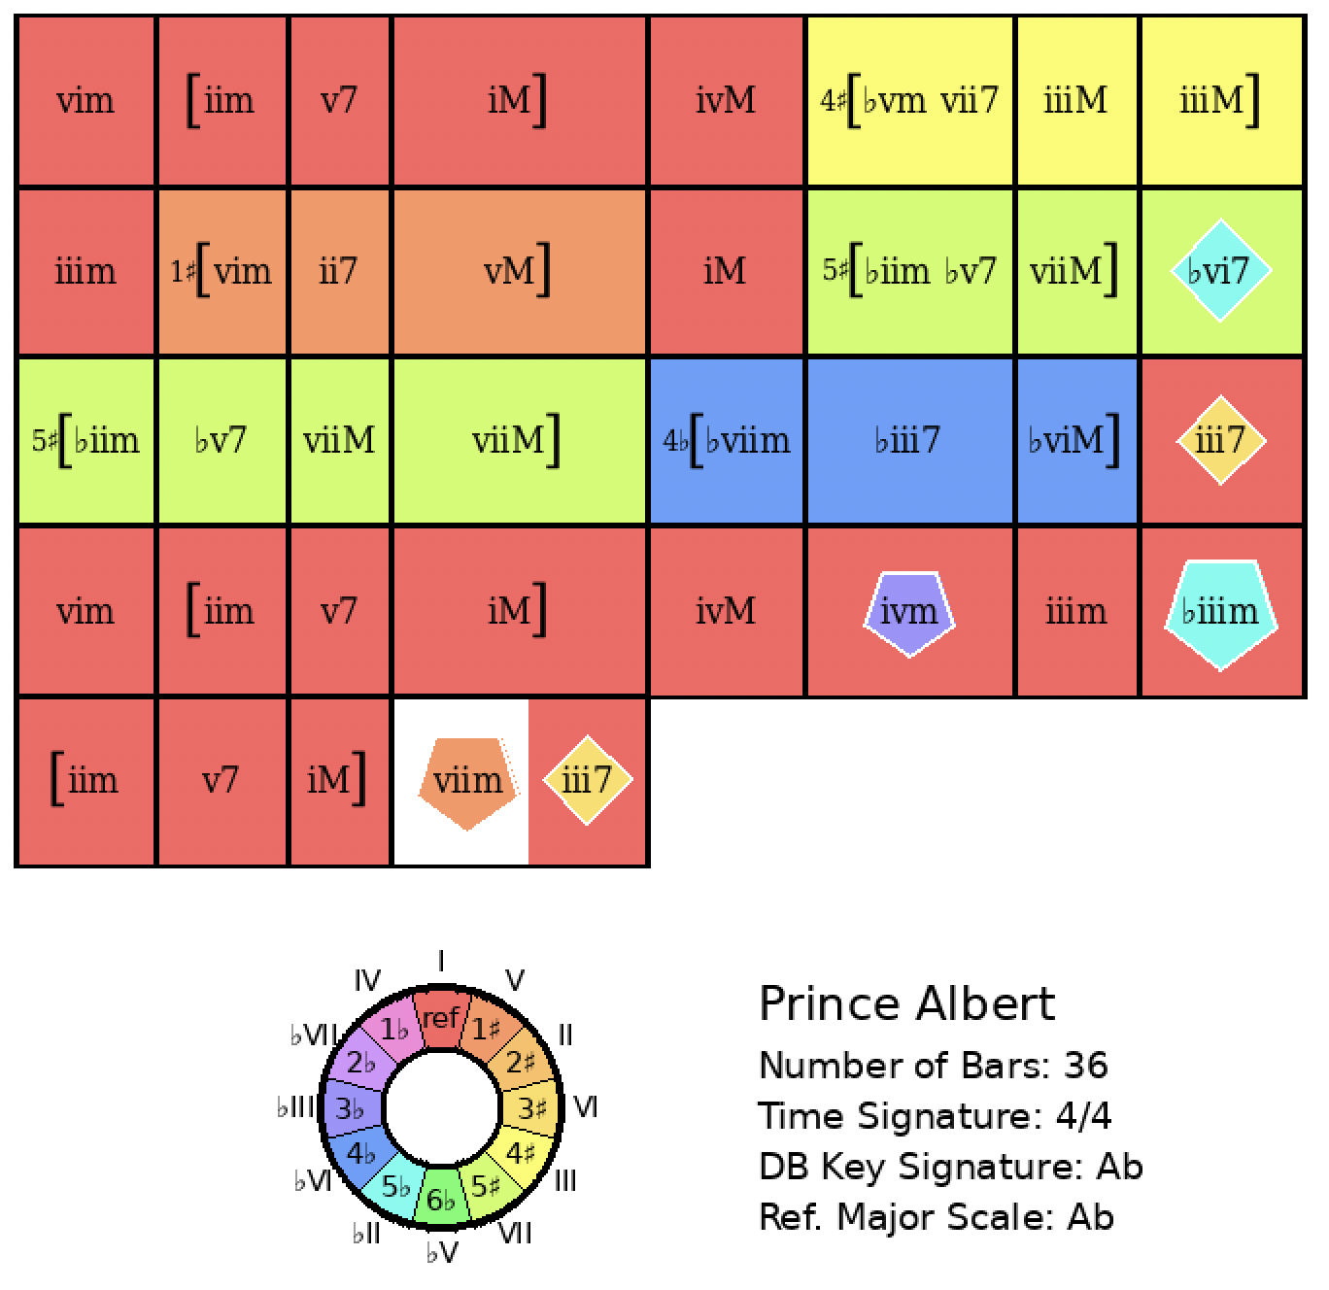
All the Things You Are
Rank = 1, Area = 0.00

Slide 5
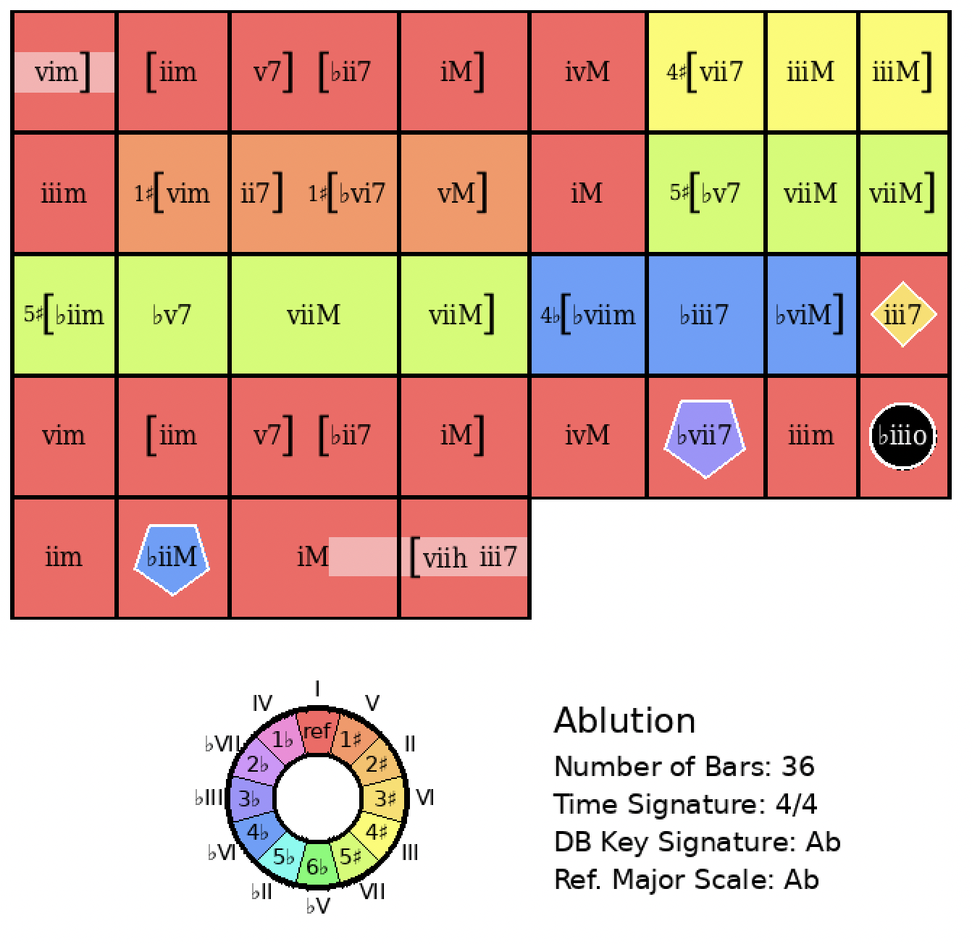
All the Things You Are
Rank = 2, Area = 7.34

Slide 6
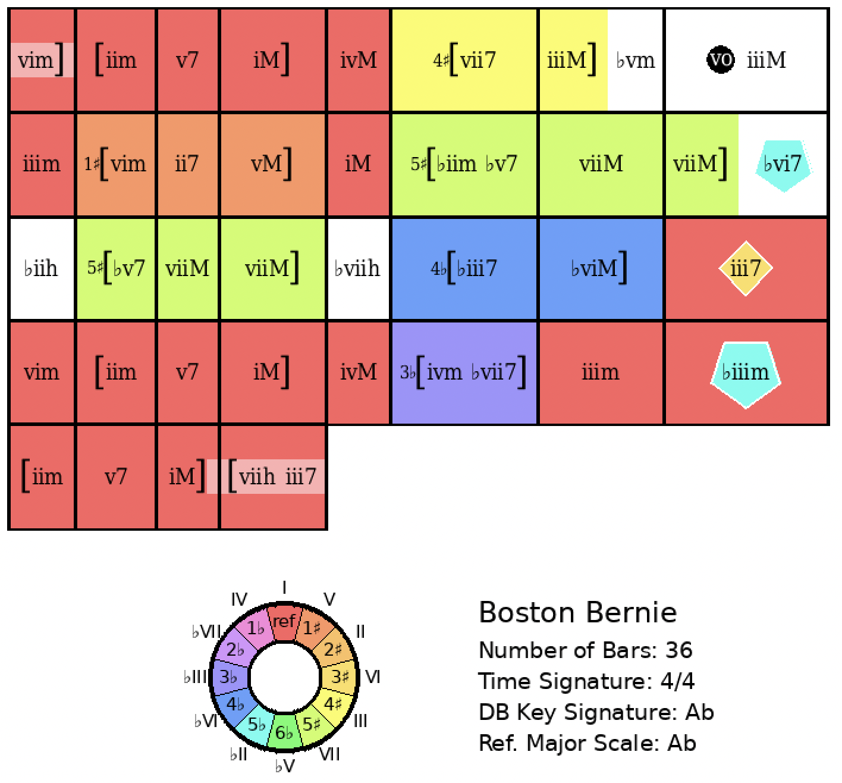
All the Things You Are
Rank = 3, Area = 8.32

Slide 7
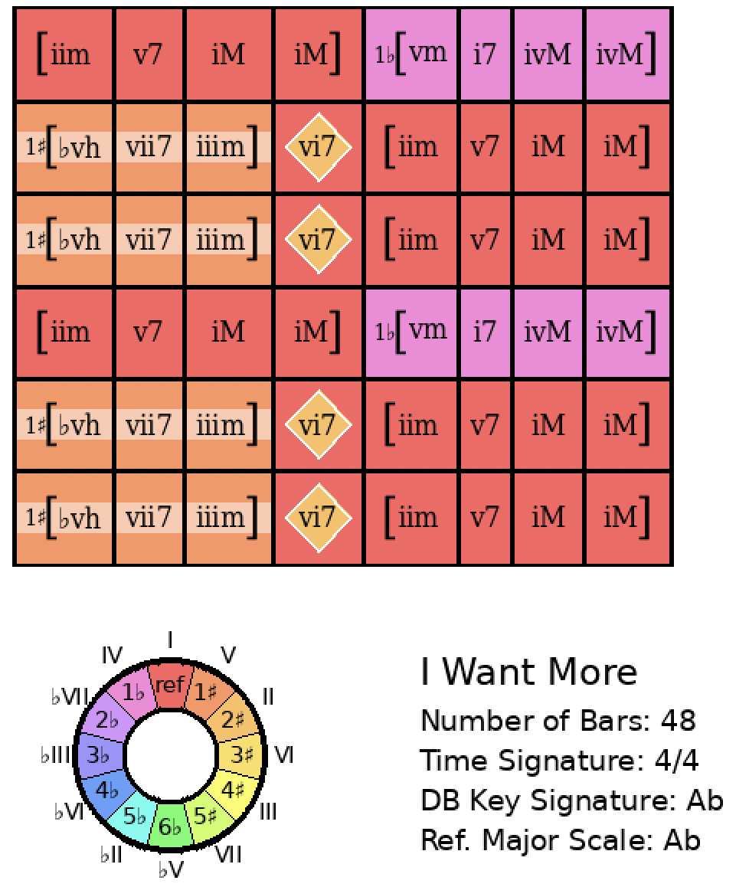
All the Things You Are
Rank = 391, Area = 36.40

Slide 8
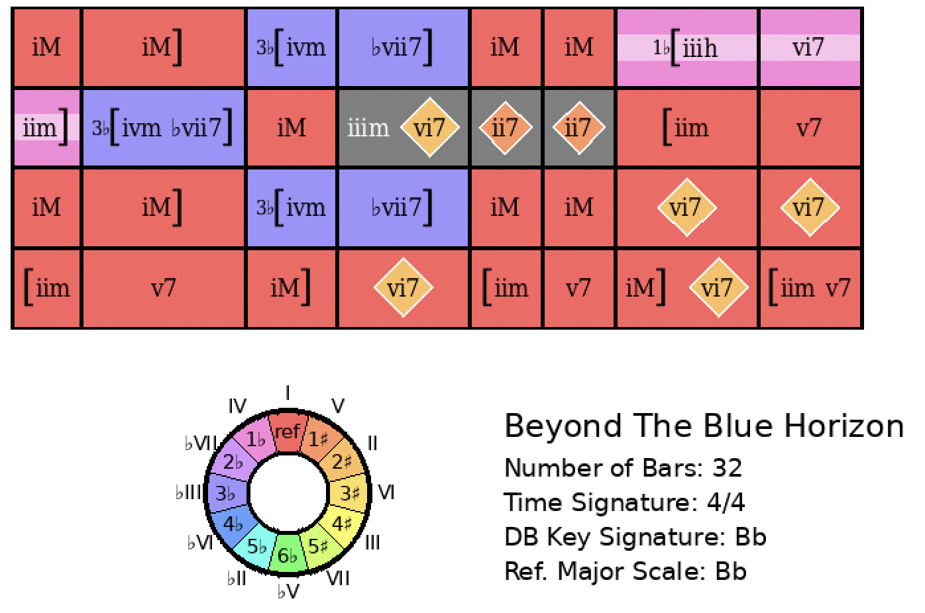
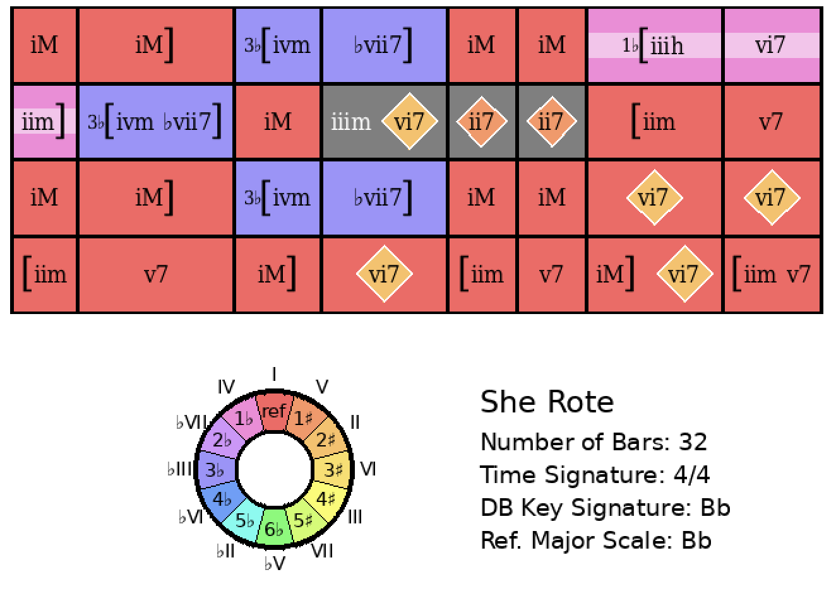
Beyond the Blue Horizon
Rank = 1, Area = 0.00

Slide 9
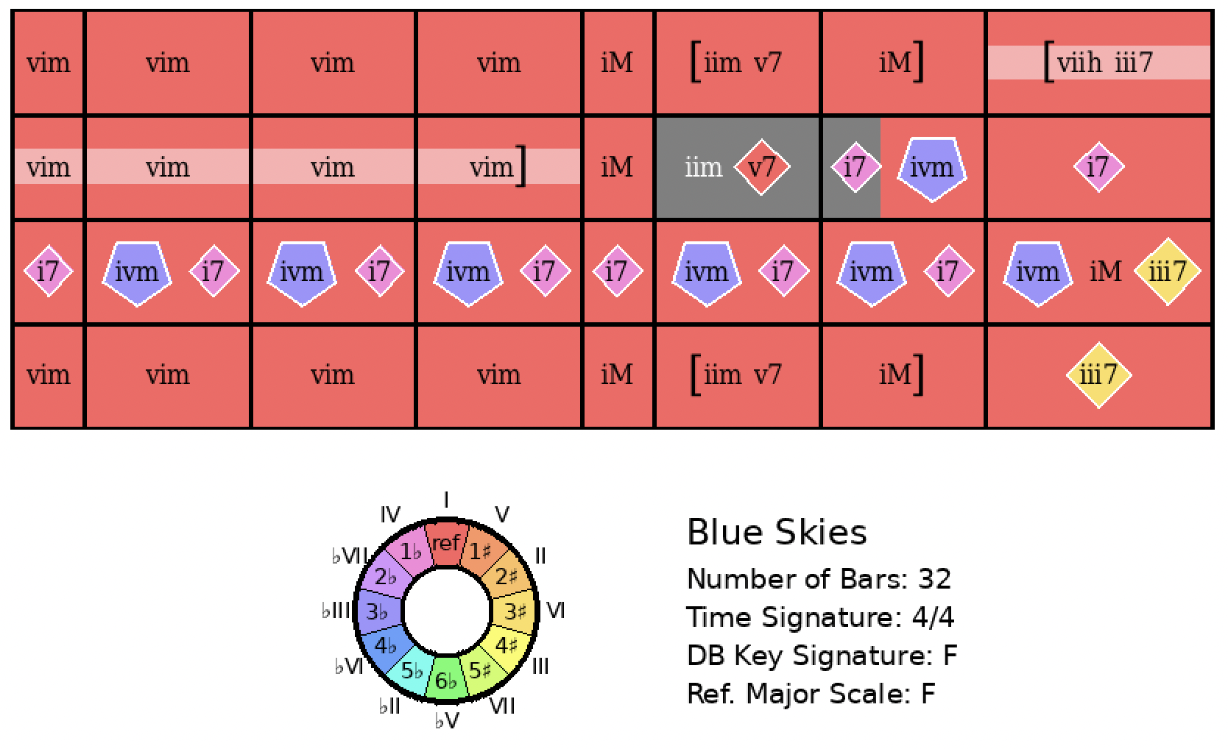
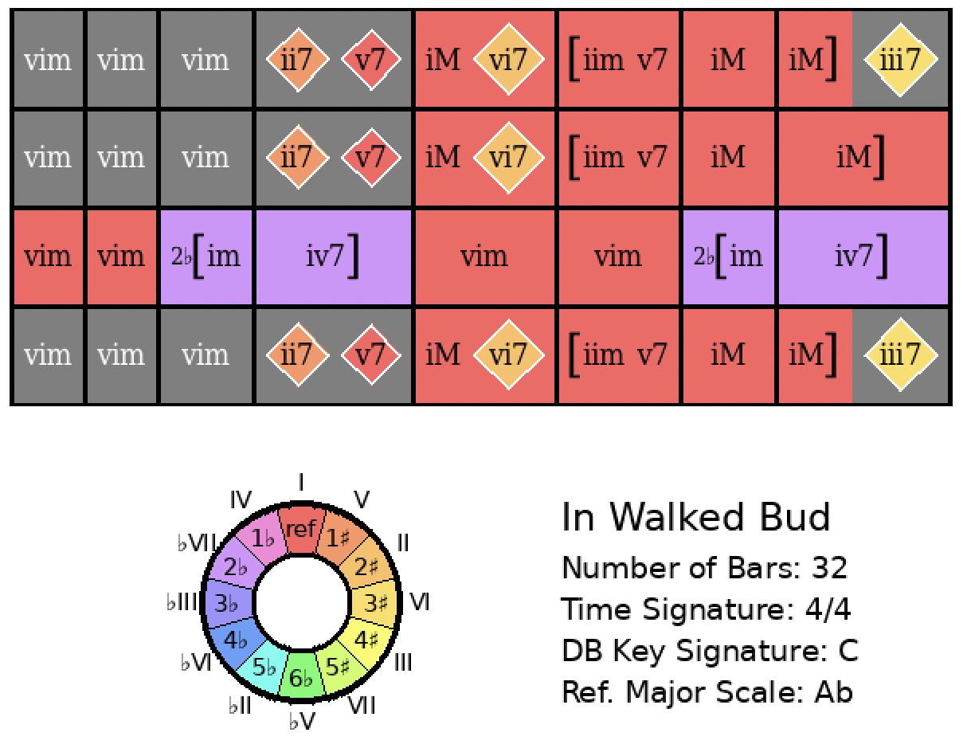
Blue Skies
Rank = 33, Area = 28.80

Slide 10
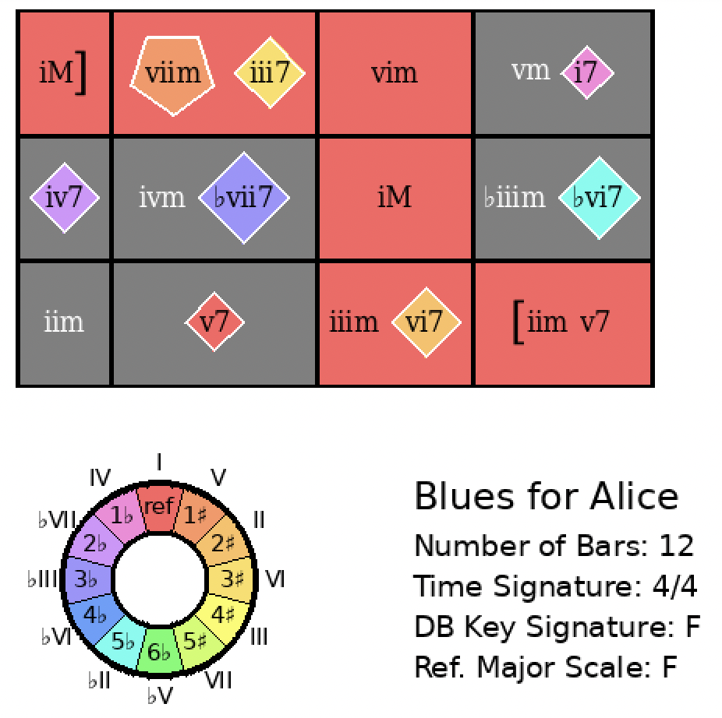
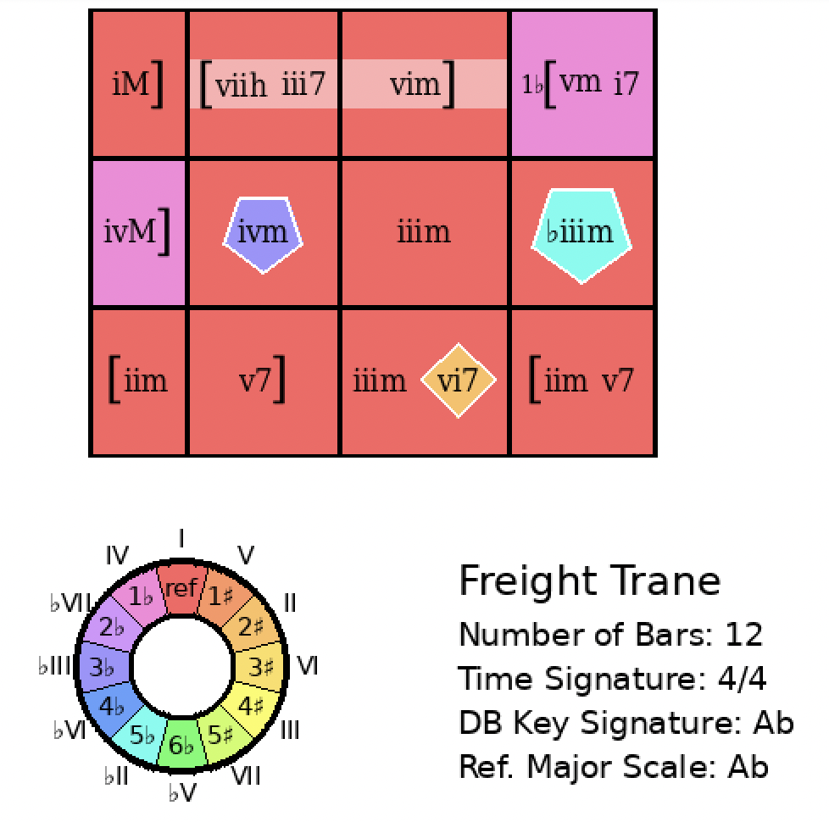
Blues for Alice
Rank = 5, Area = 22.63

Slide 11
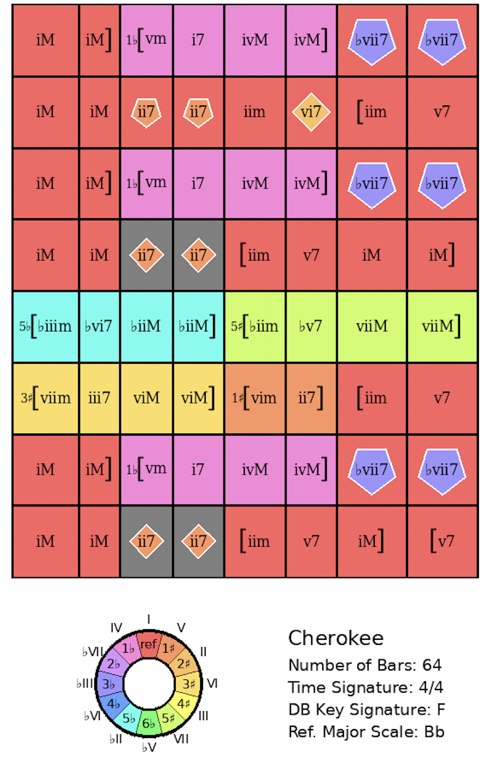
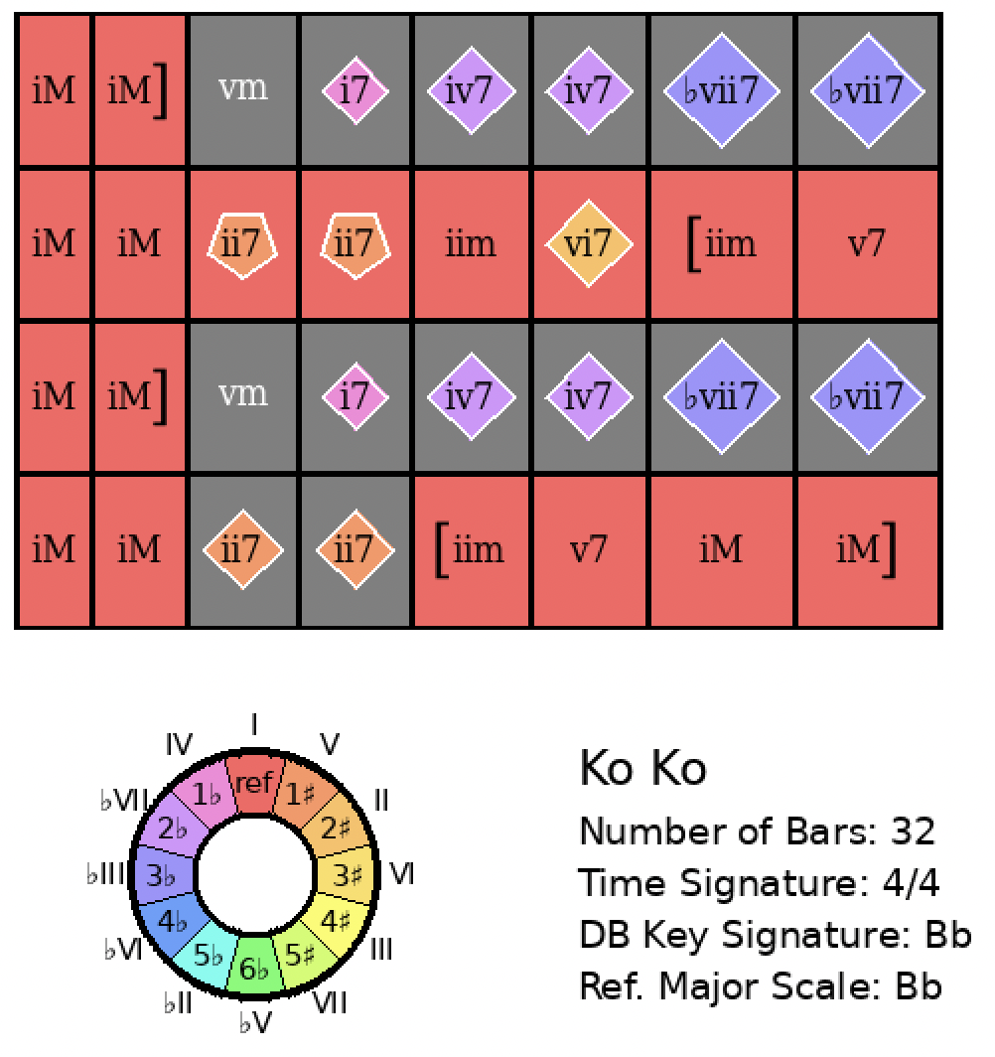
Cherokee
Rank = 80, Area = 20.99

Slide 12
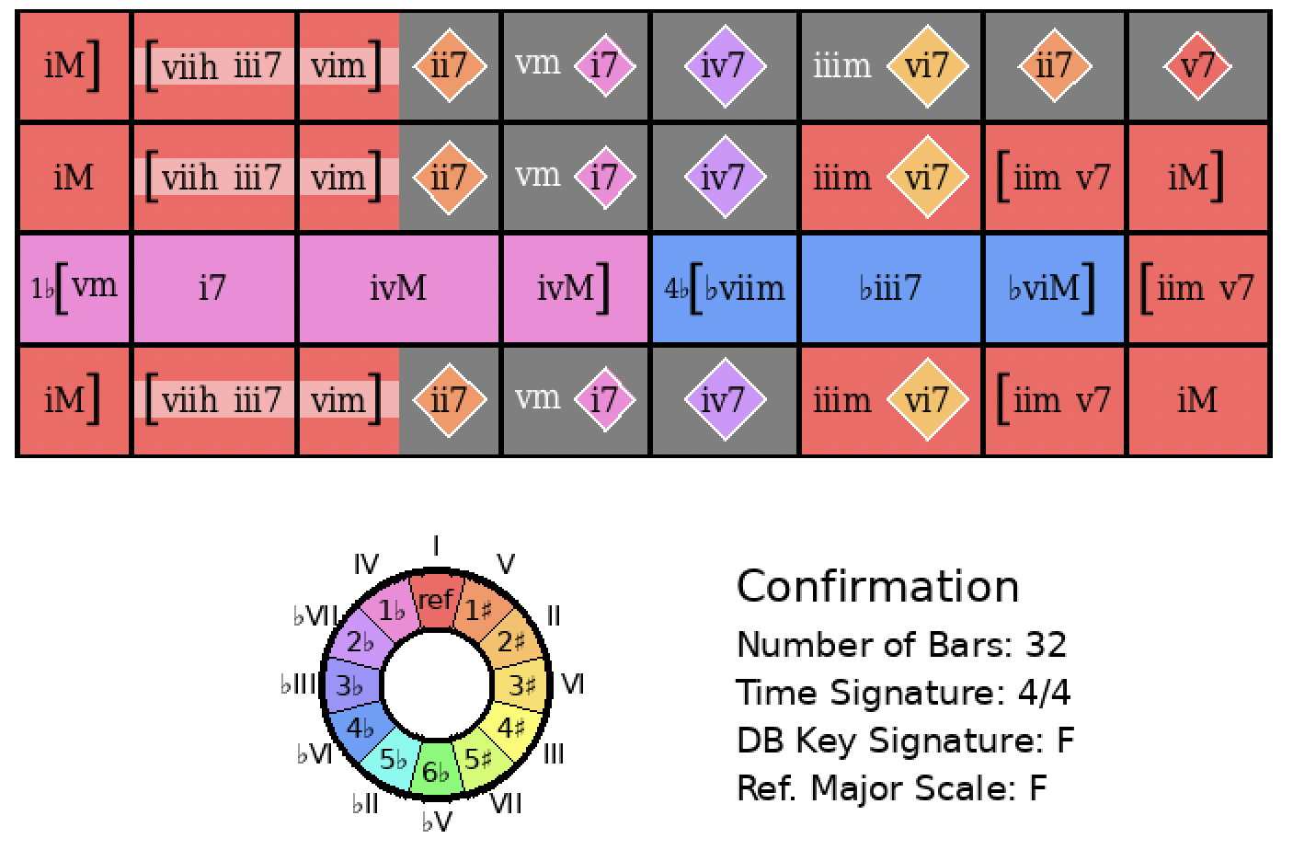
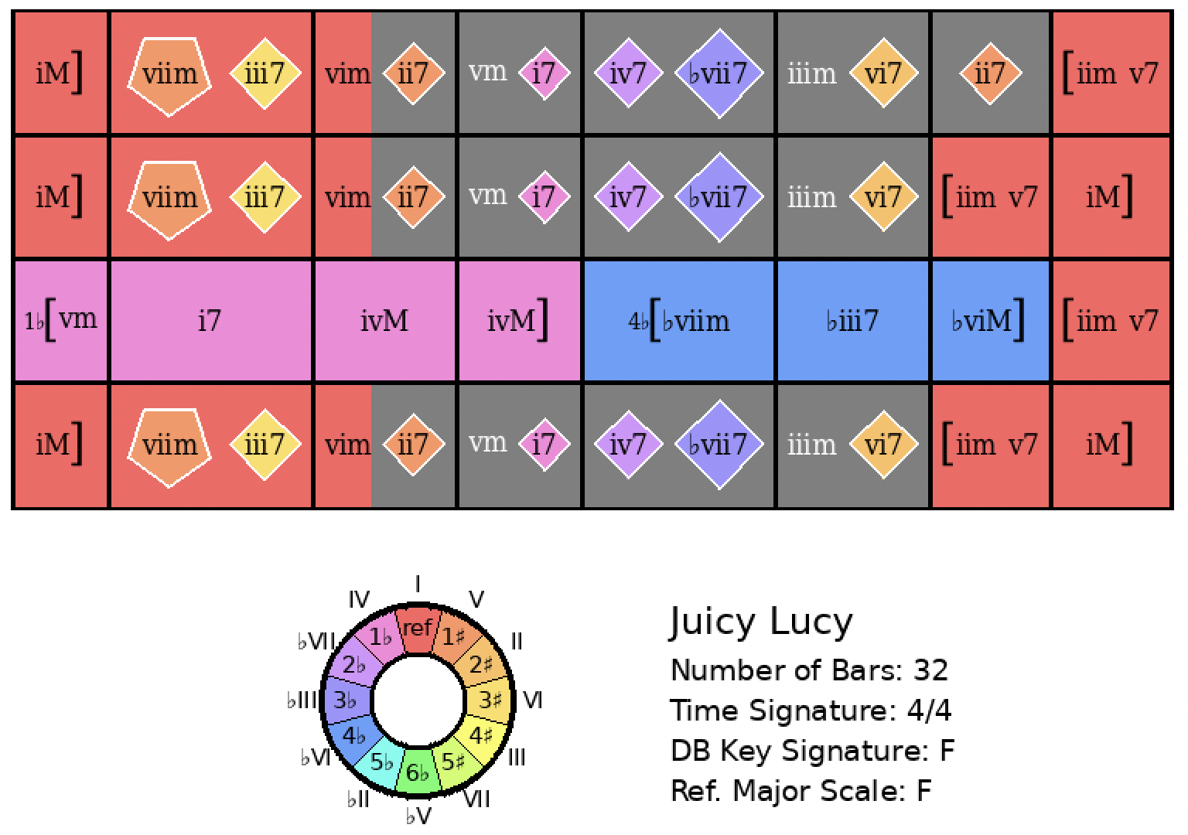
Confirmation
Rank = 1, Area = 7.38

Slide 13
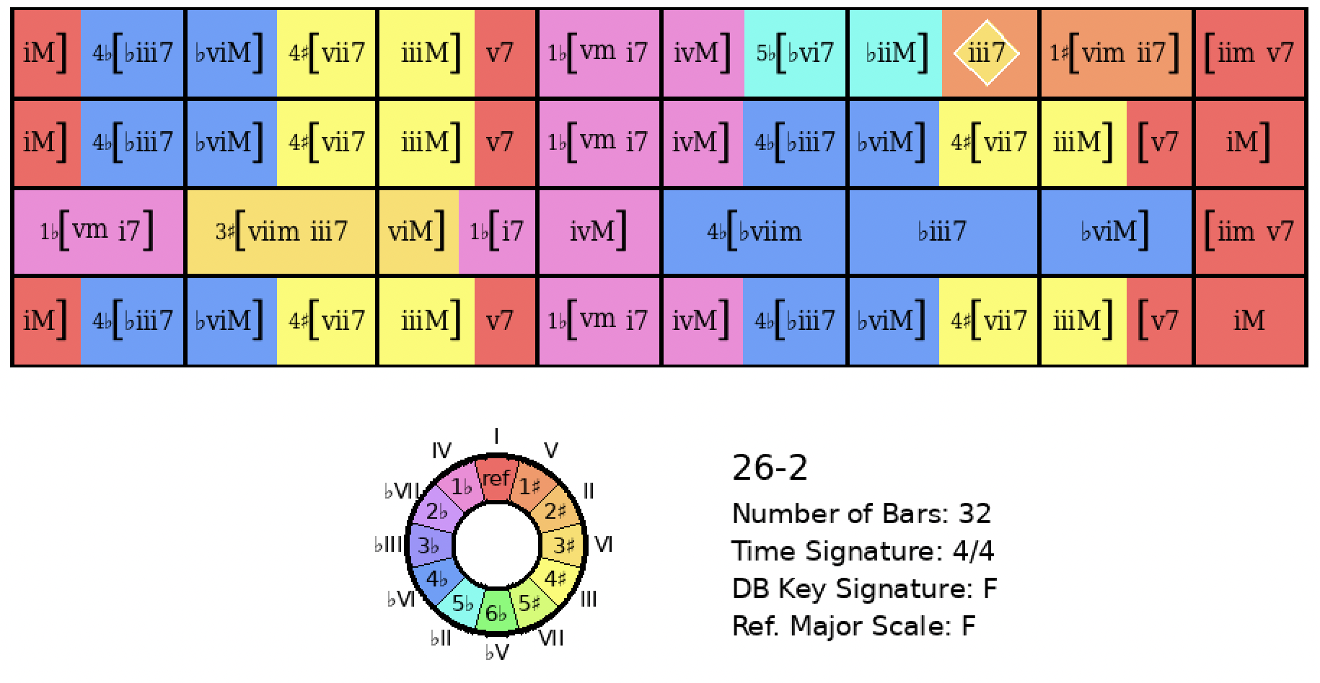
Confirmation
Rank = 243, Area = 29.12

Slide 14
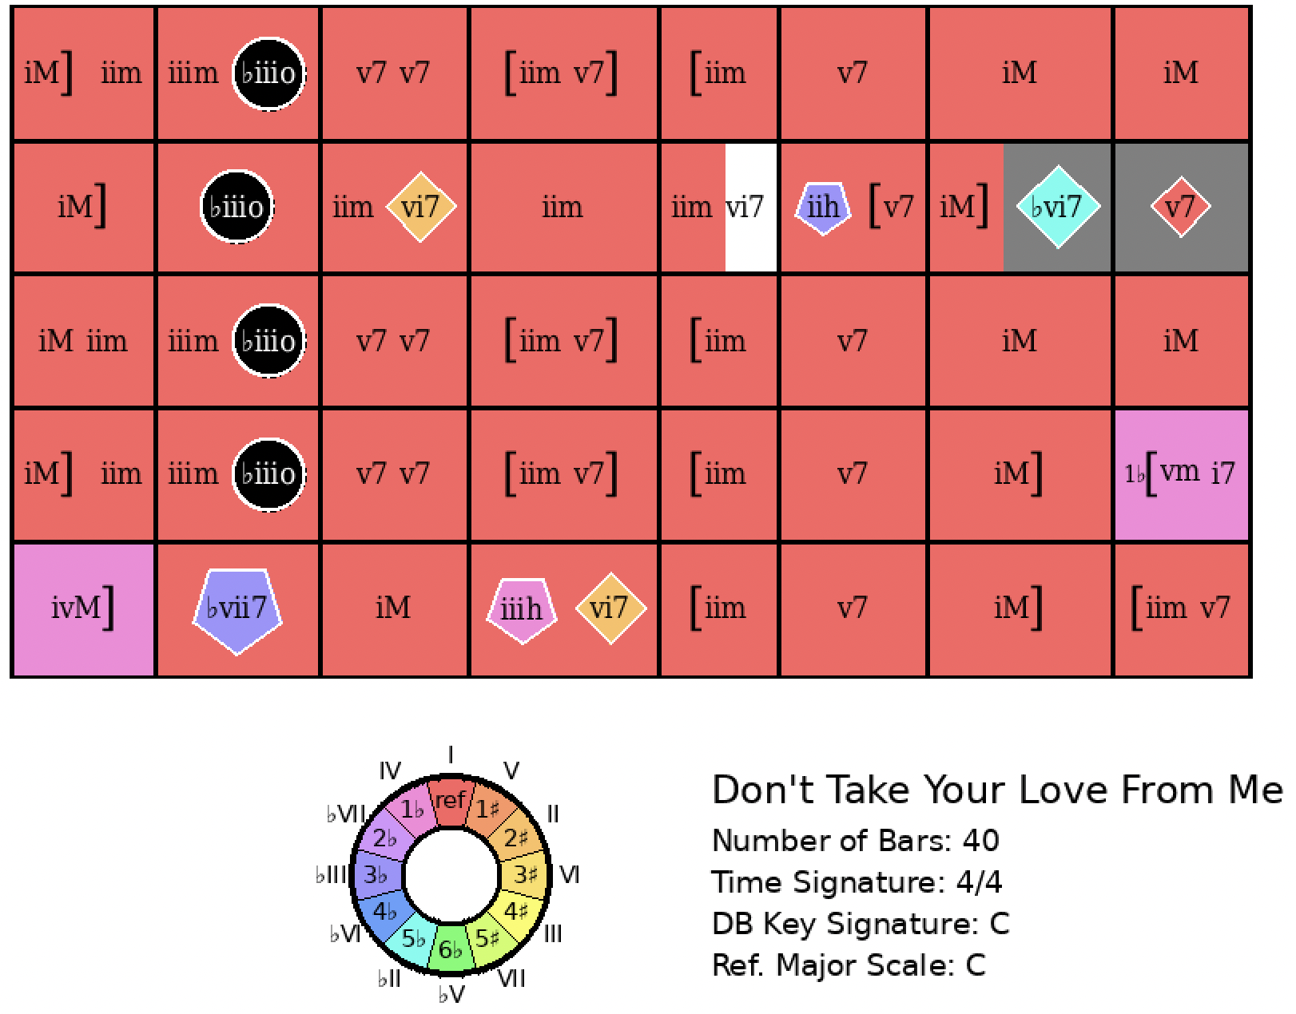
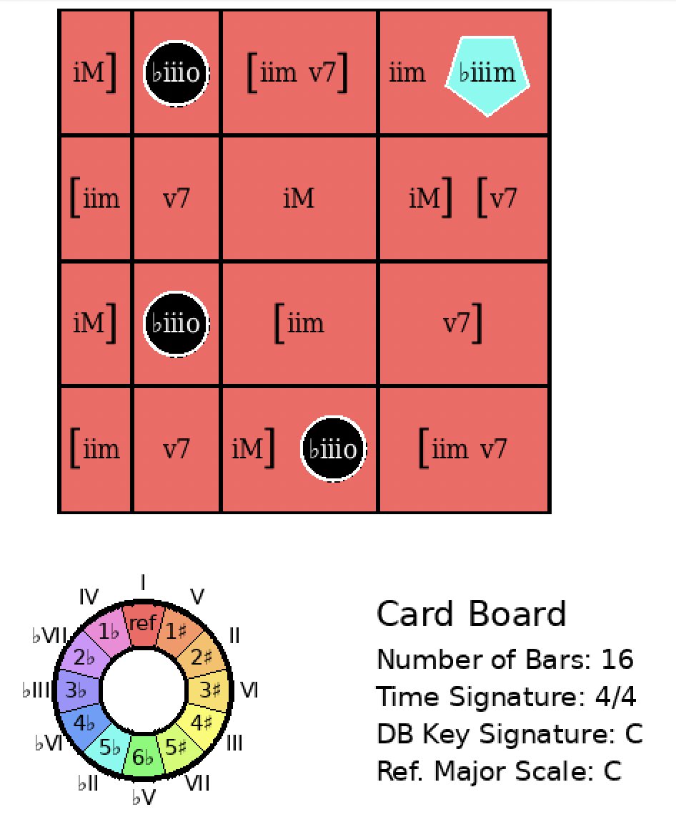
Don’t Take Your Love From Me
Rank = 9, Area = 11.65

Slide 15
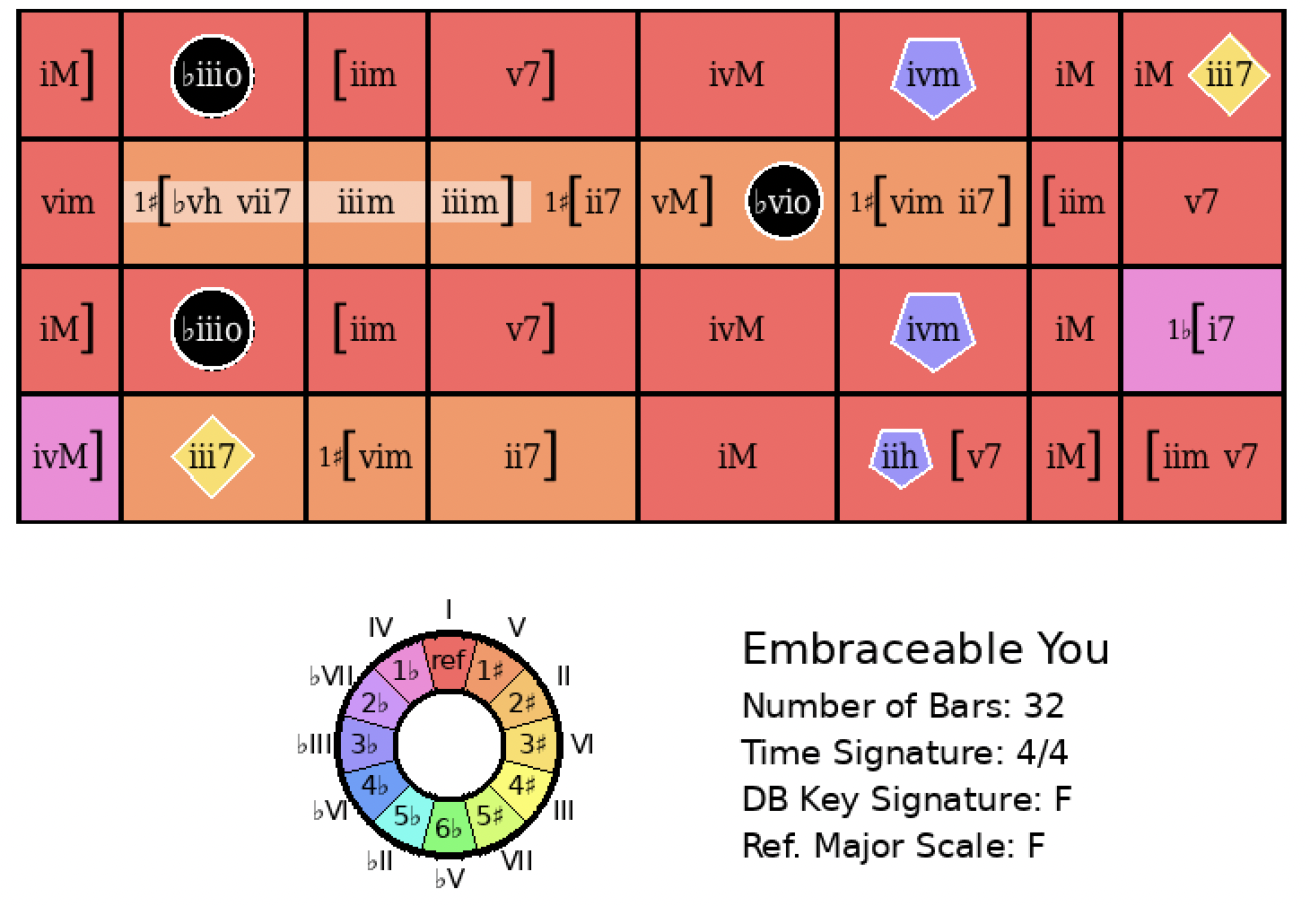
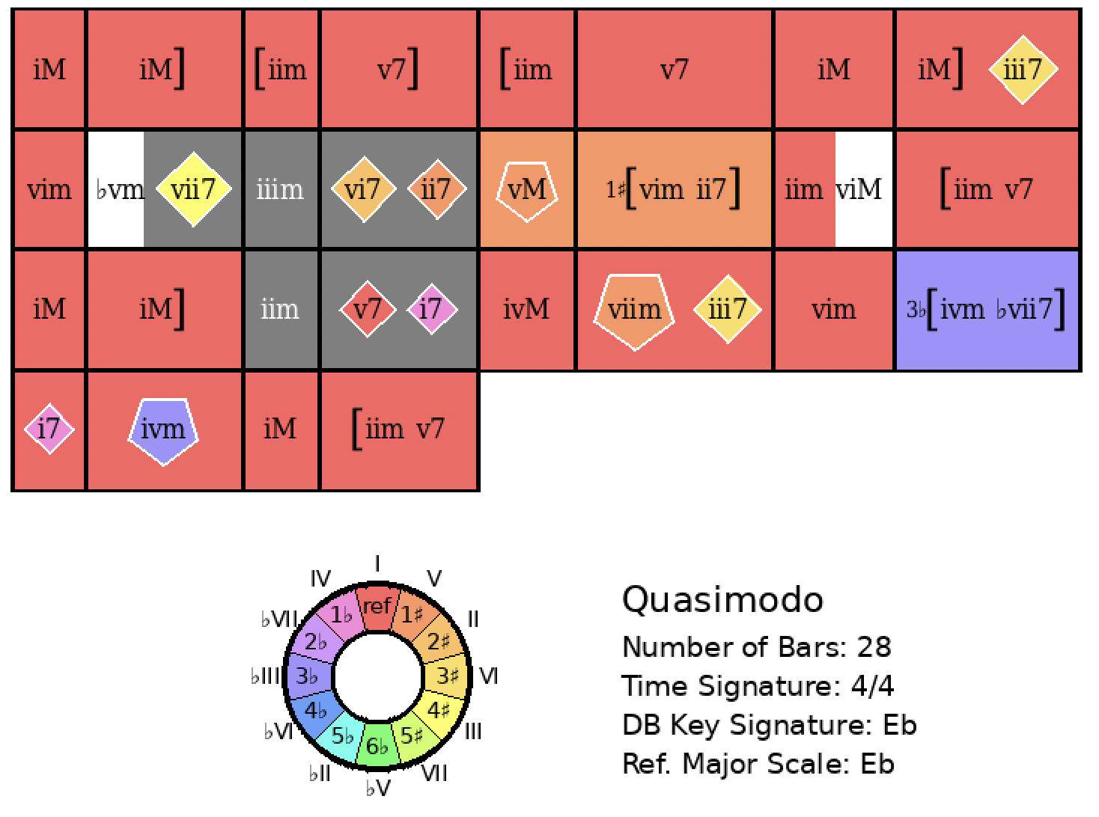
Embraceable You
Rank = 40, Area = 18.21

Slide 16
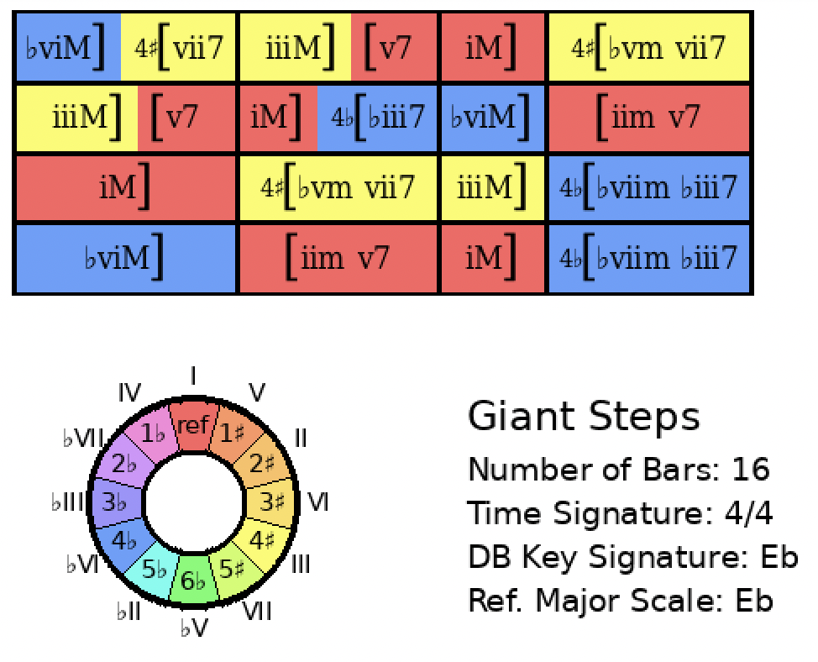
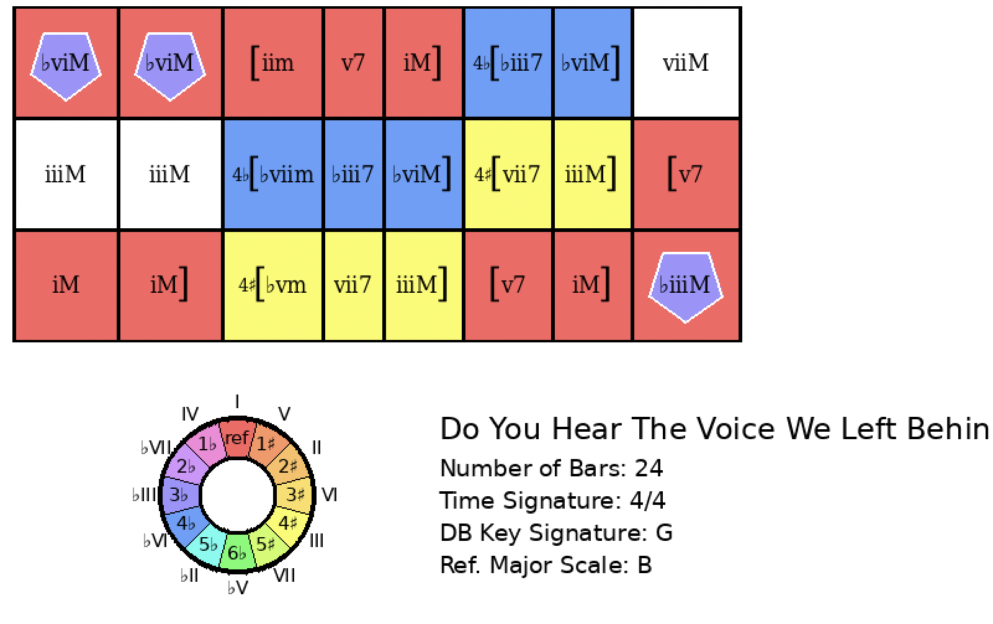
Giant Steps
Rank = 5, Area = 28.21

Slide 17
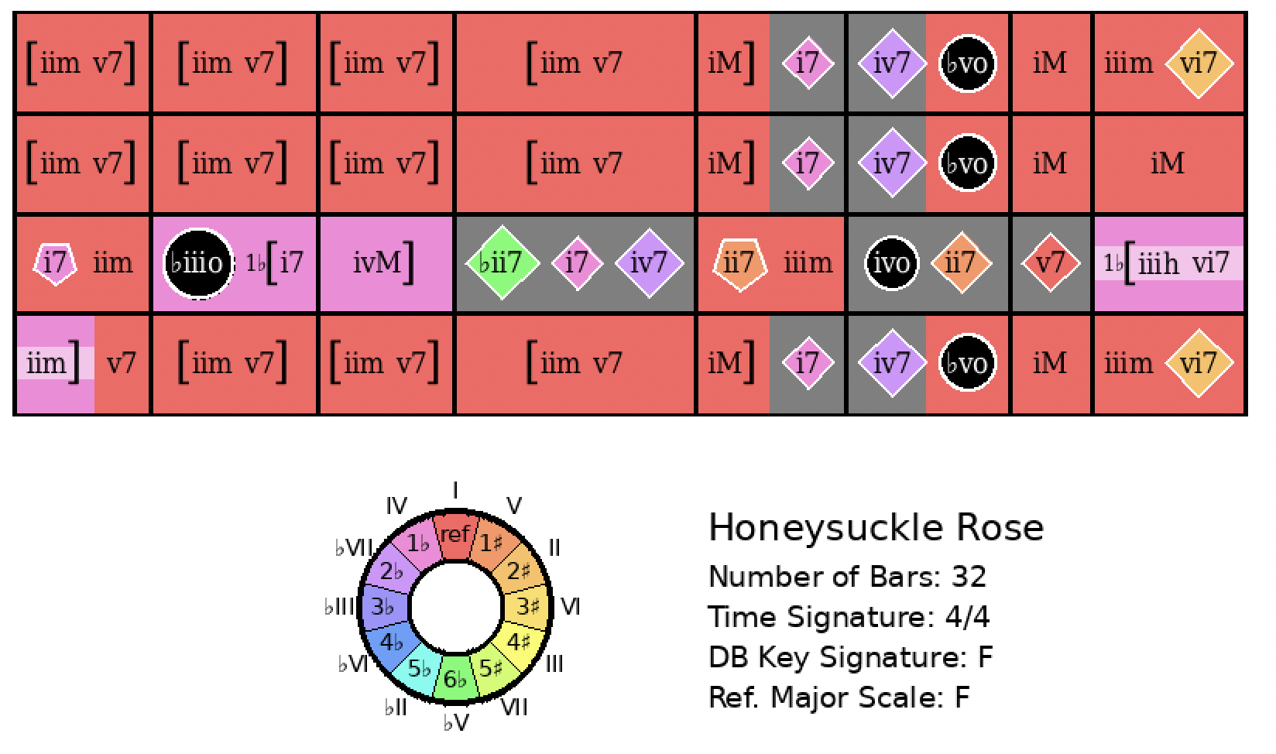
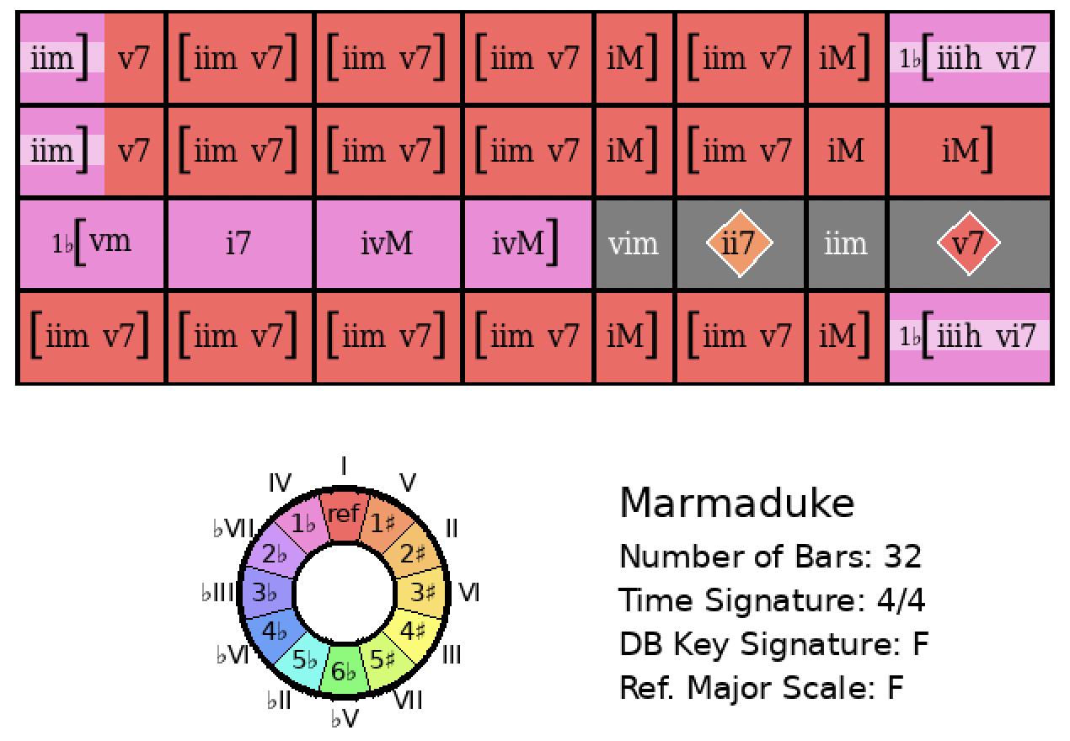
Honeysuckle Rose
Rank = 12, Area = 14.02

Slide 18
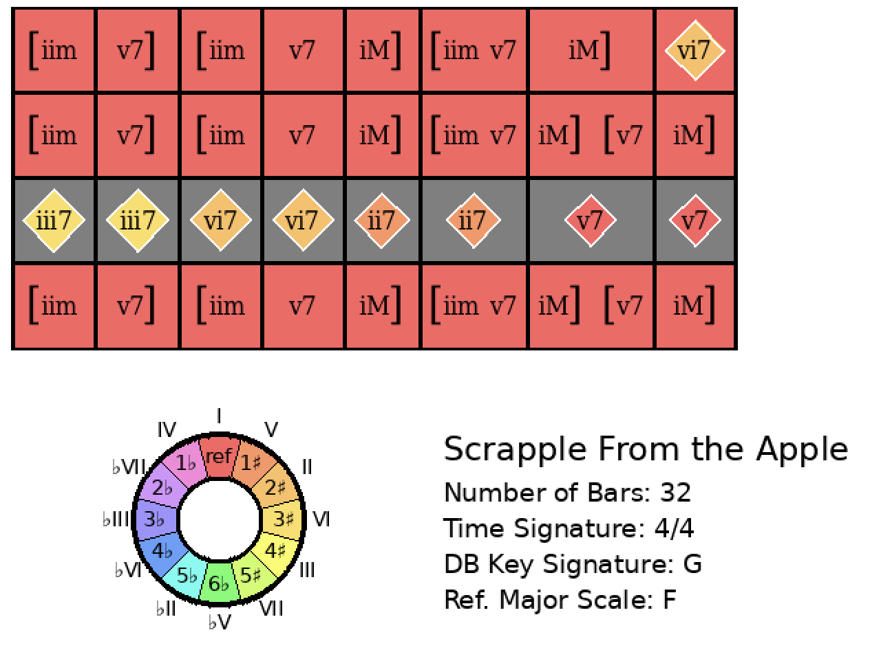
Honeysuckle Rose
Rank = 428, Area = 23.97

Slide 19
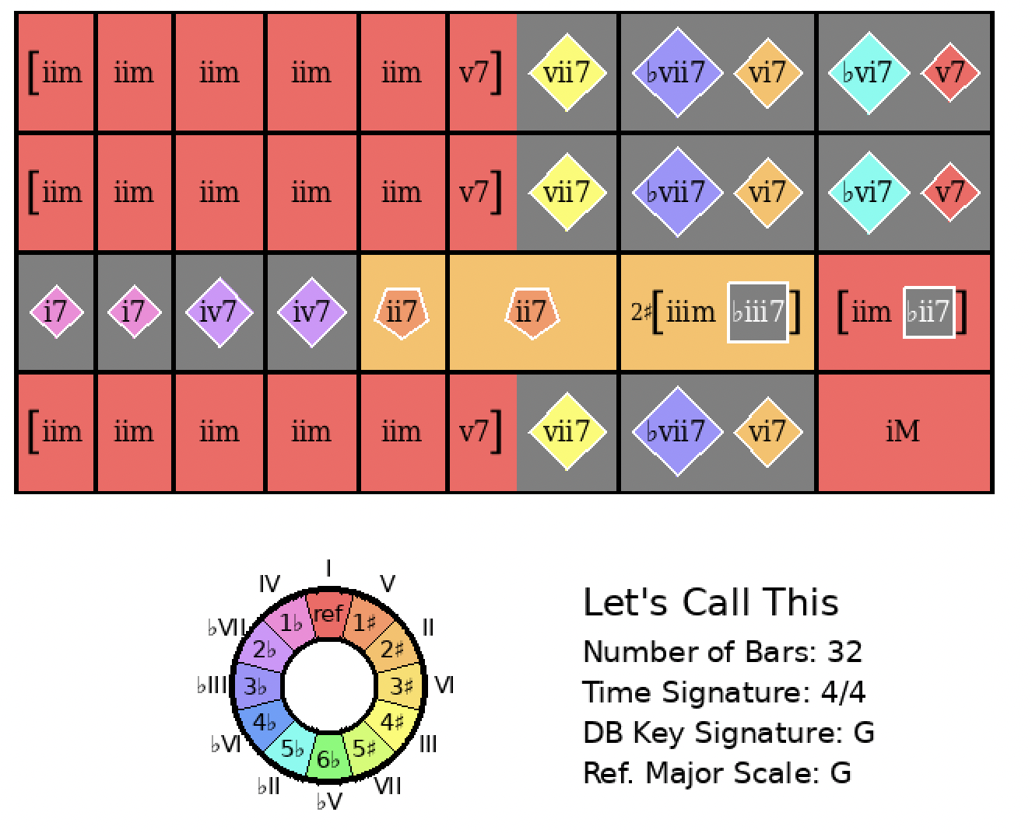
Honeysuckle Rose
Rank = 1141, Area = 32.25

Slide 20
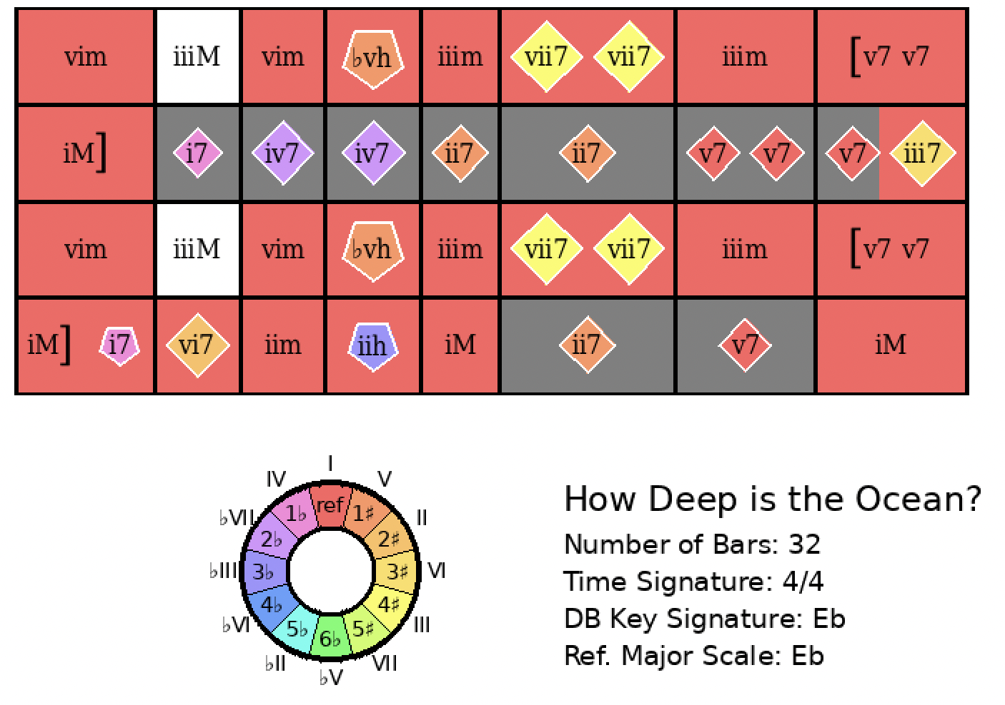
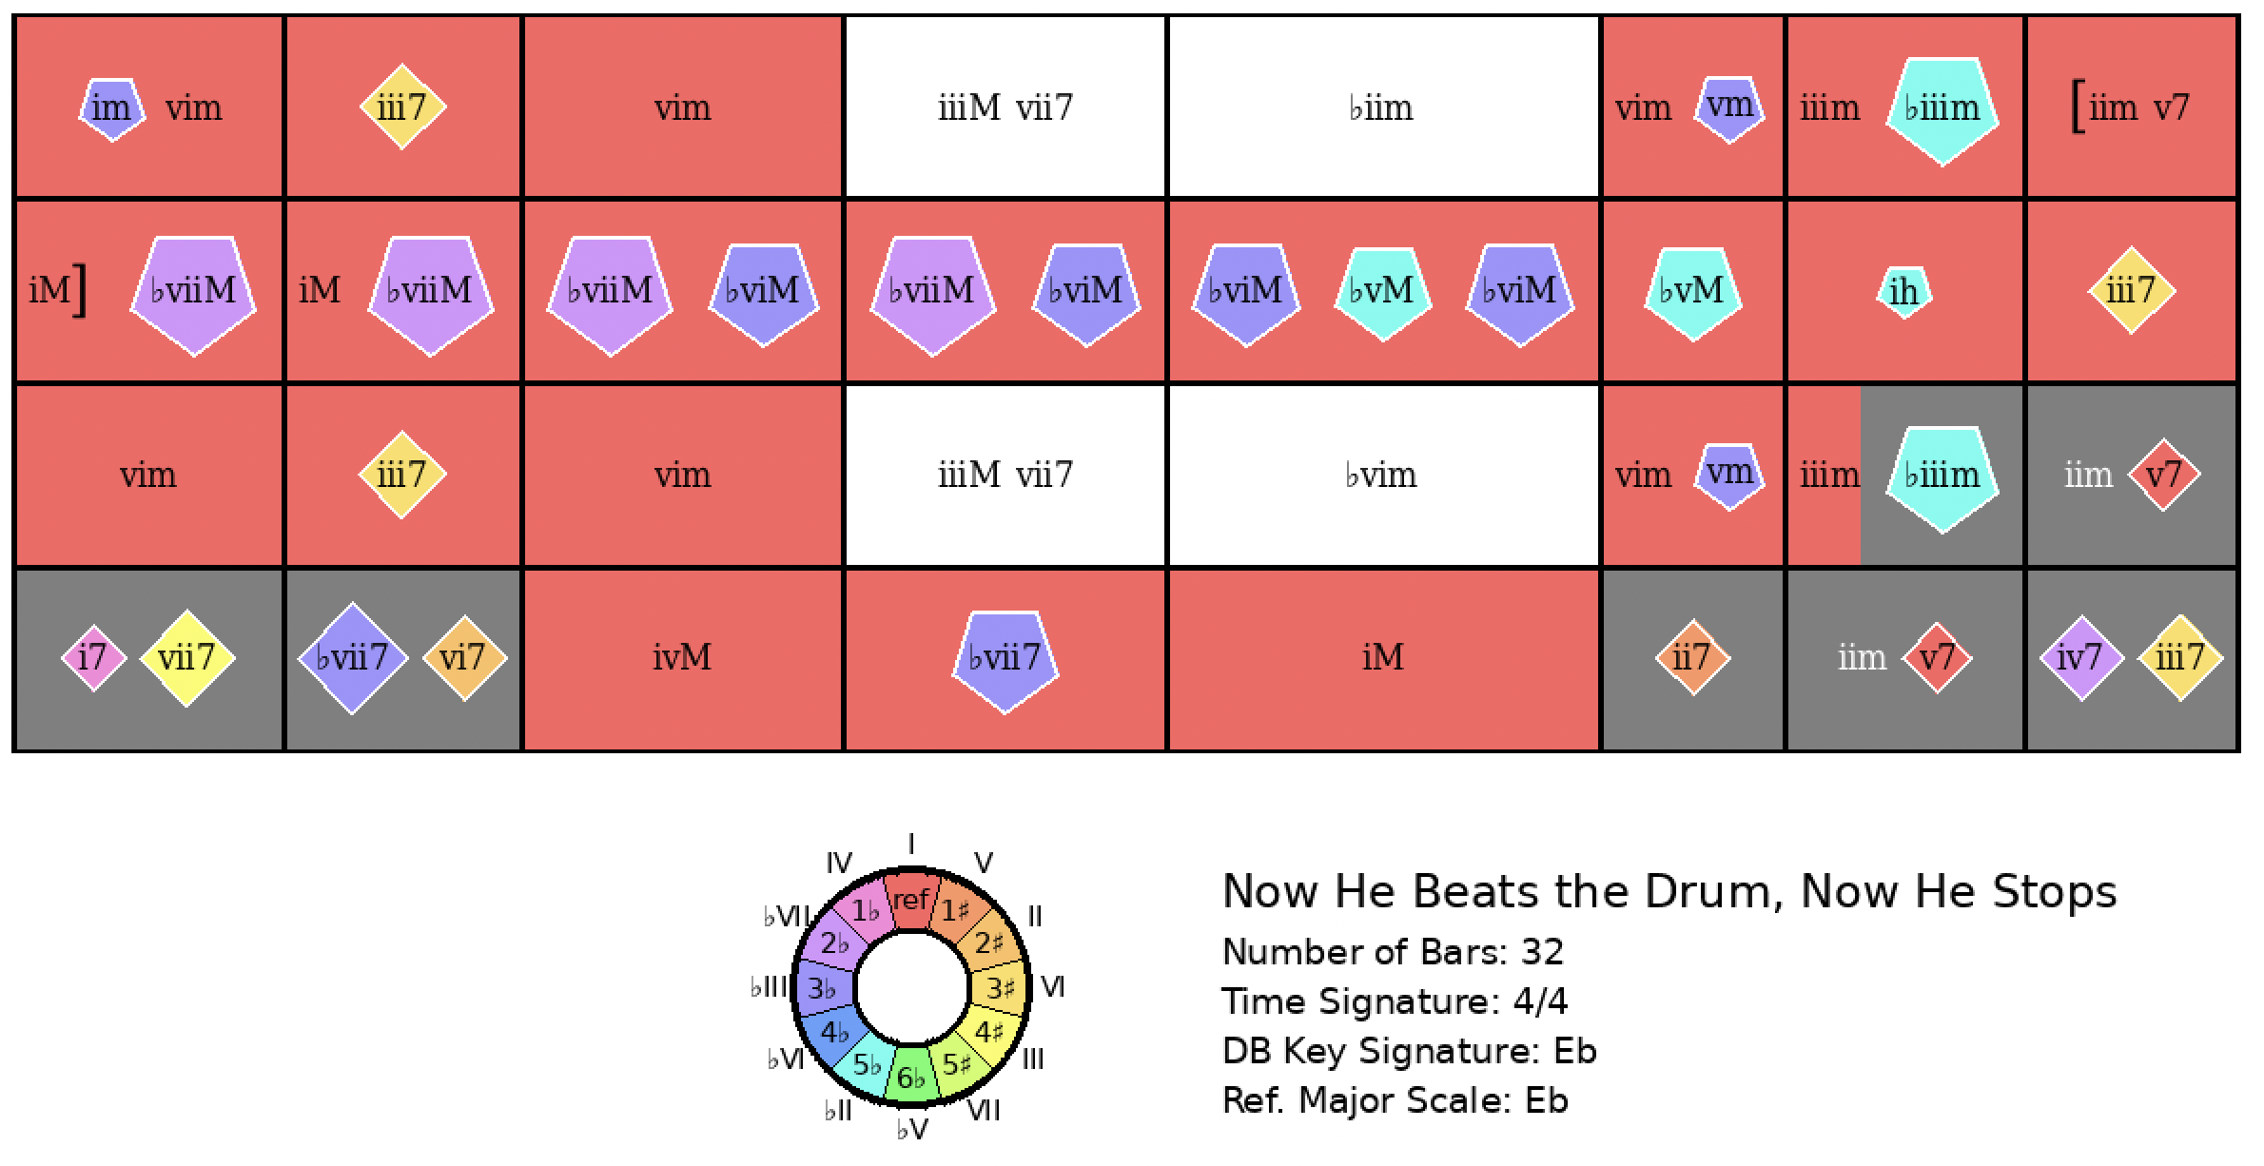
How Deep Is The Ocean?
Rank = 128, Area = 31.77

Slide 21
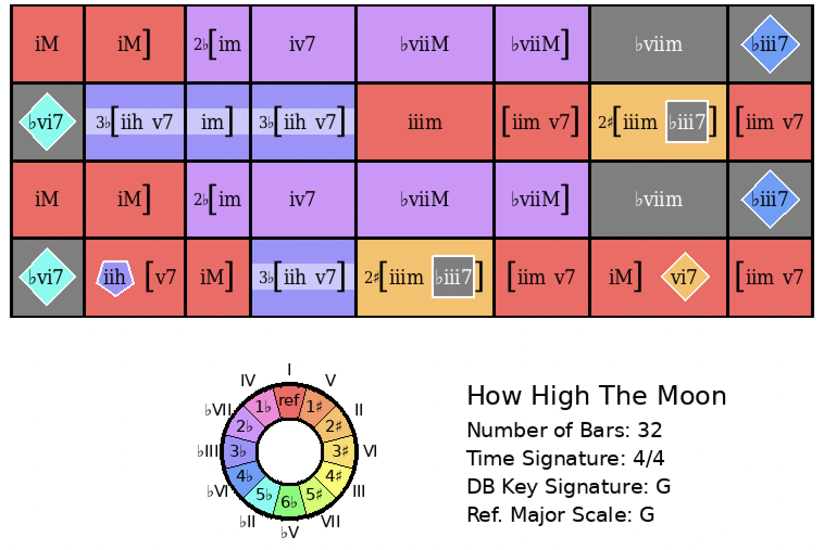
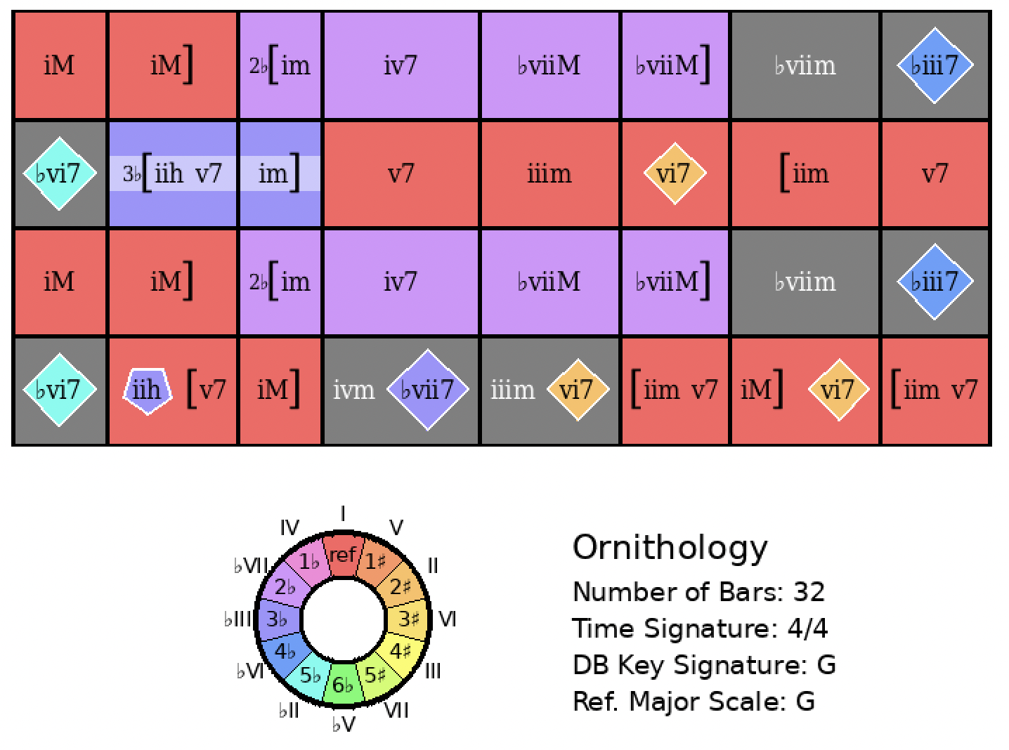
How High the Moon
Rank = 1, Area = 11.55

Slide 22
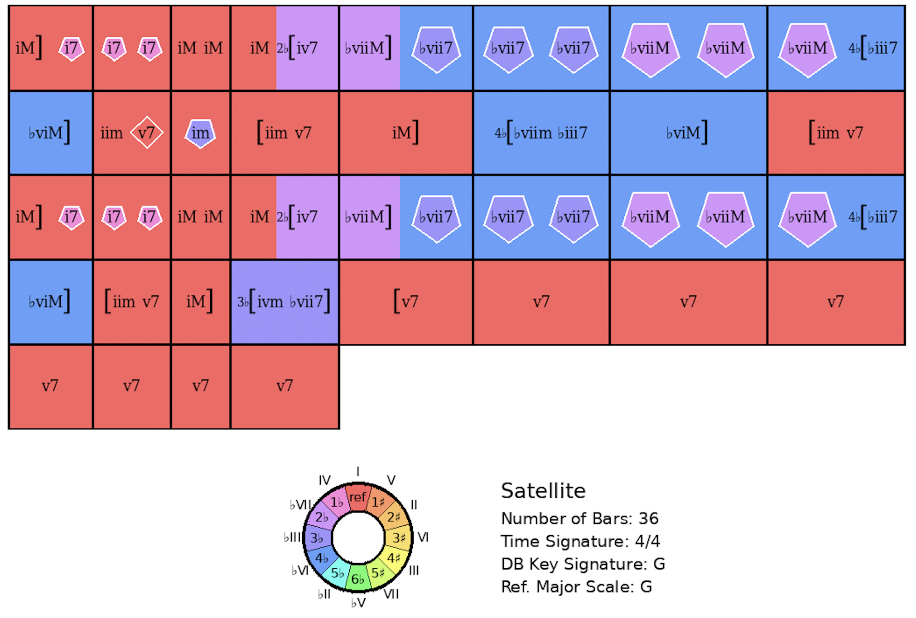
How High the Moon
Rank = 6, Area = 23.97

Slide 23
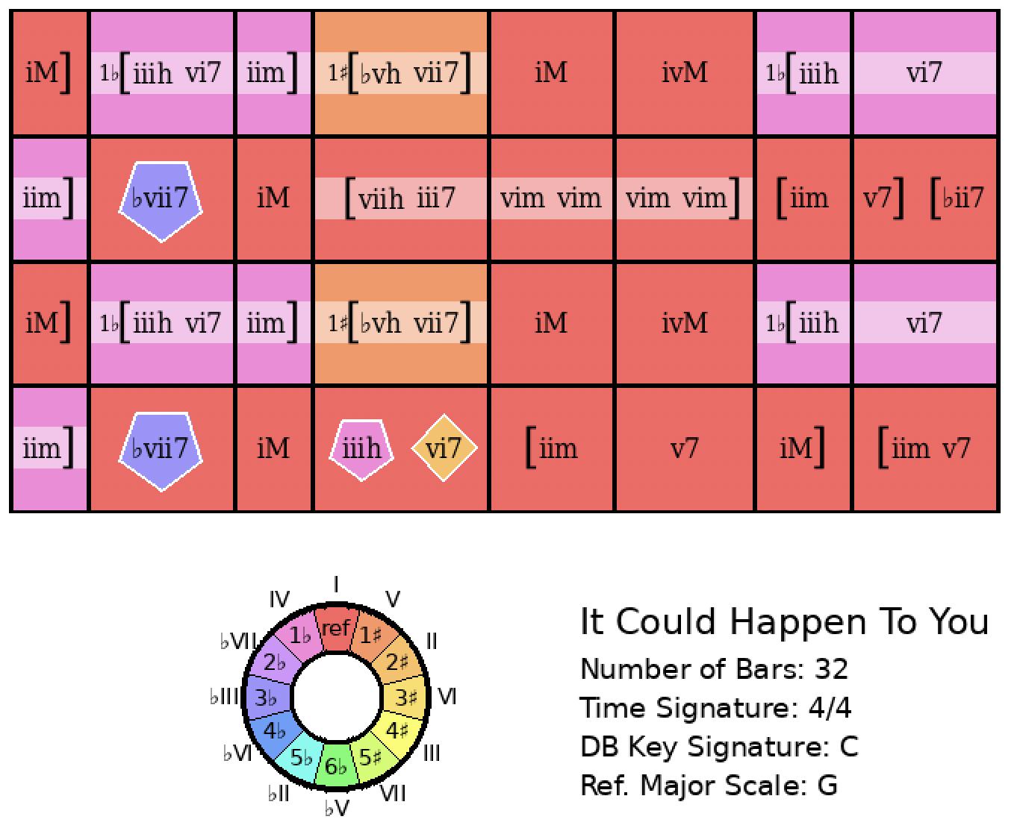
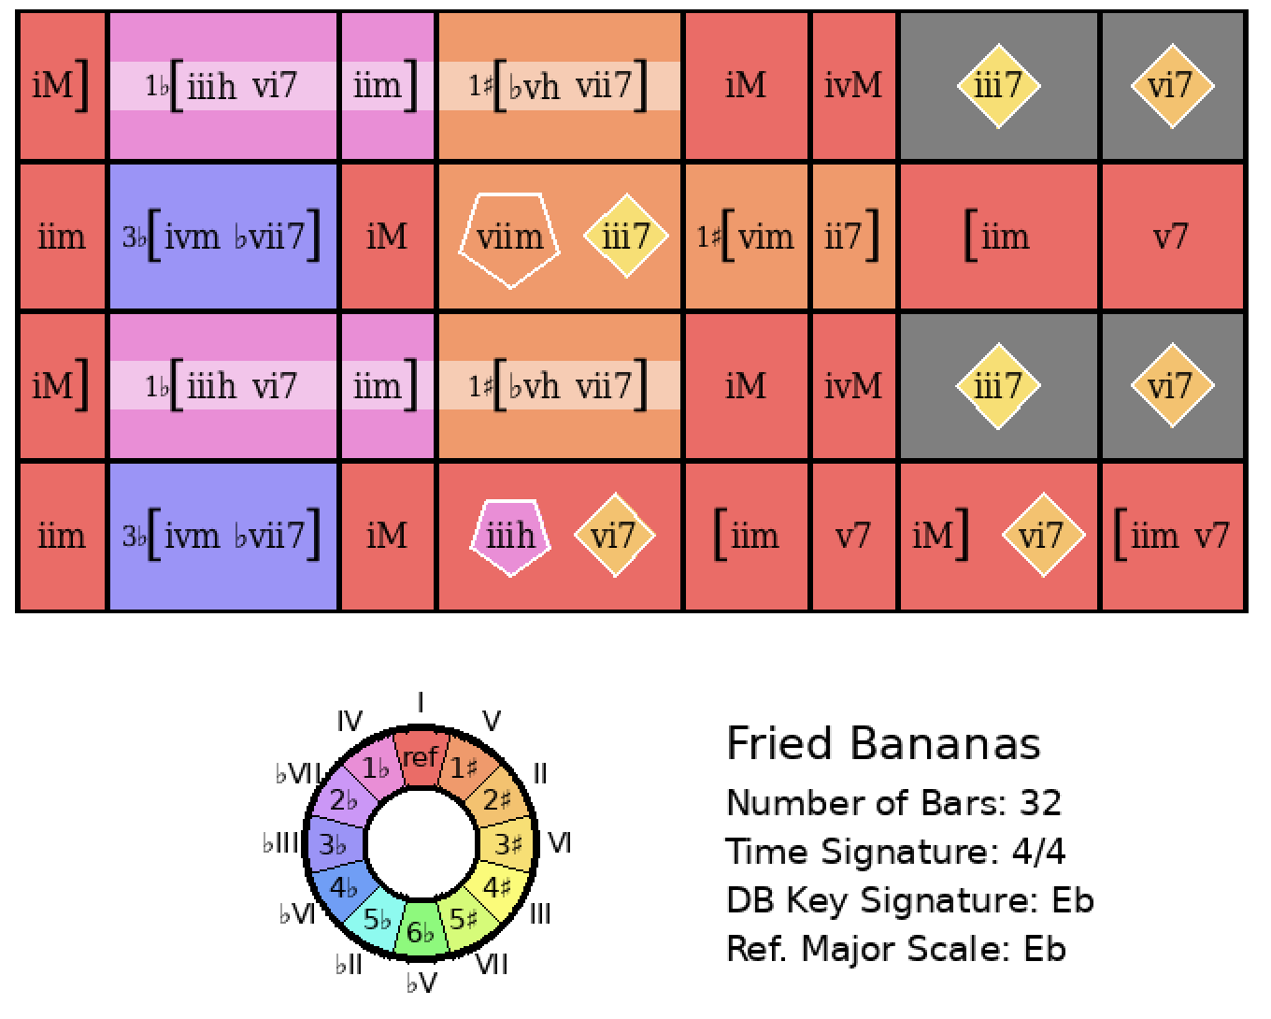
It Could Happen to You
Rank = 1, Area = 9.86

Slide 24
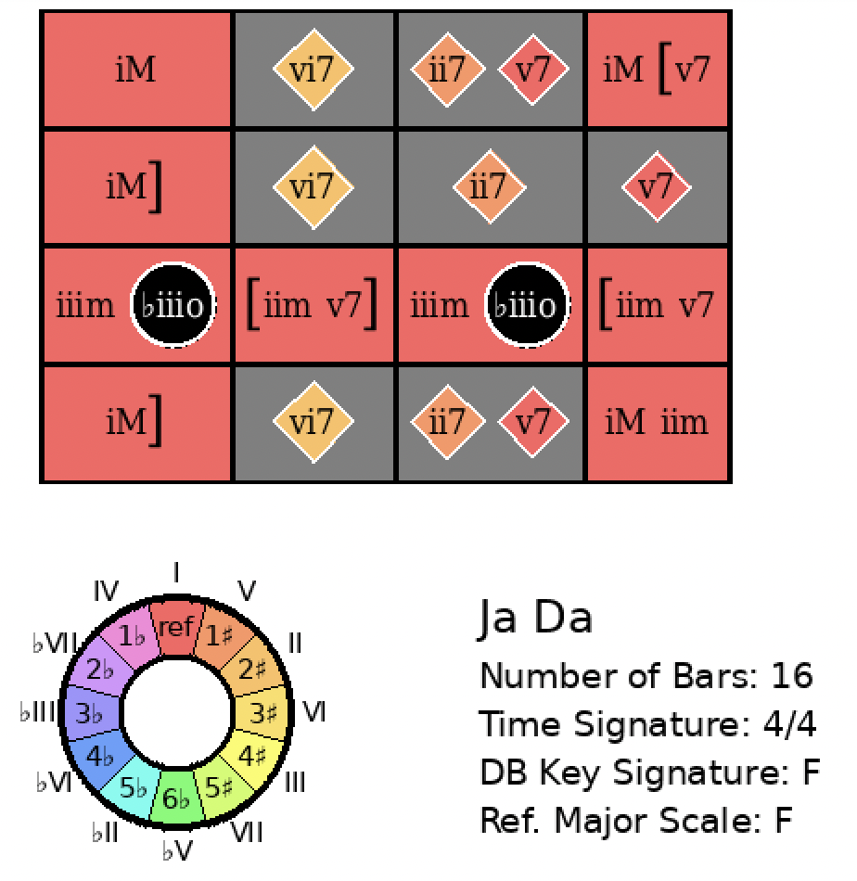
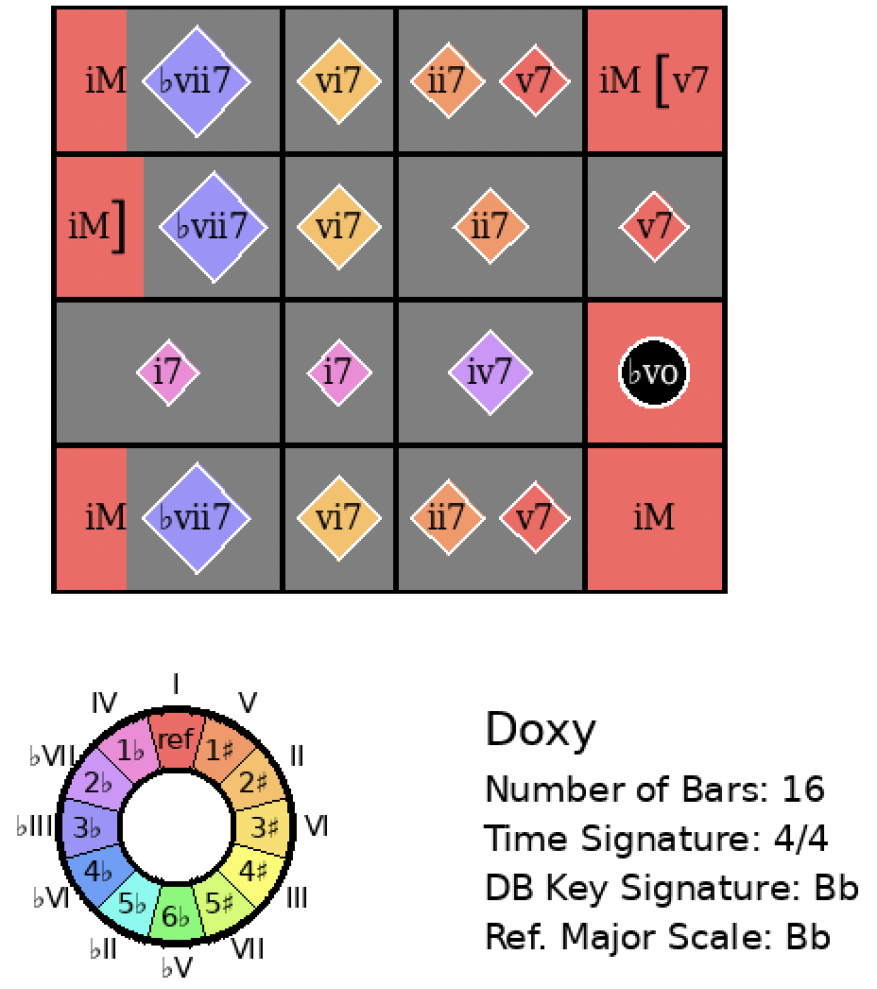
Ja Da
Rank = 312, Area = 27.35

Slide 25
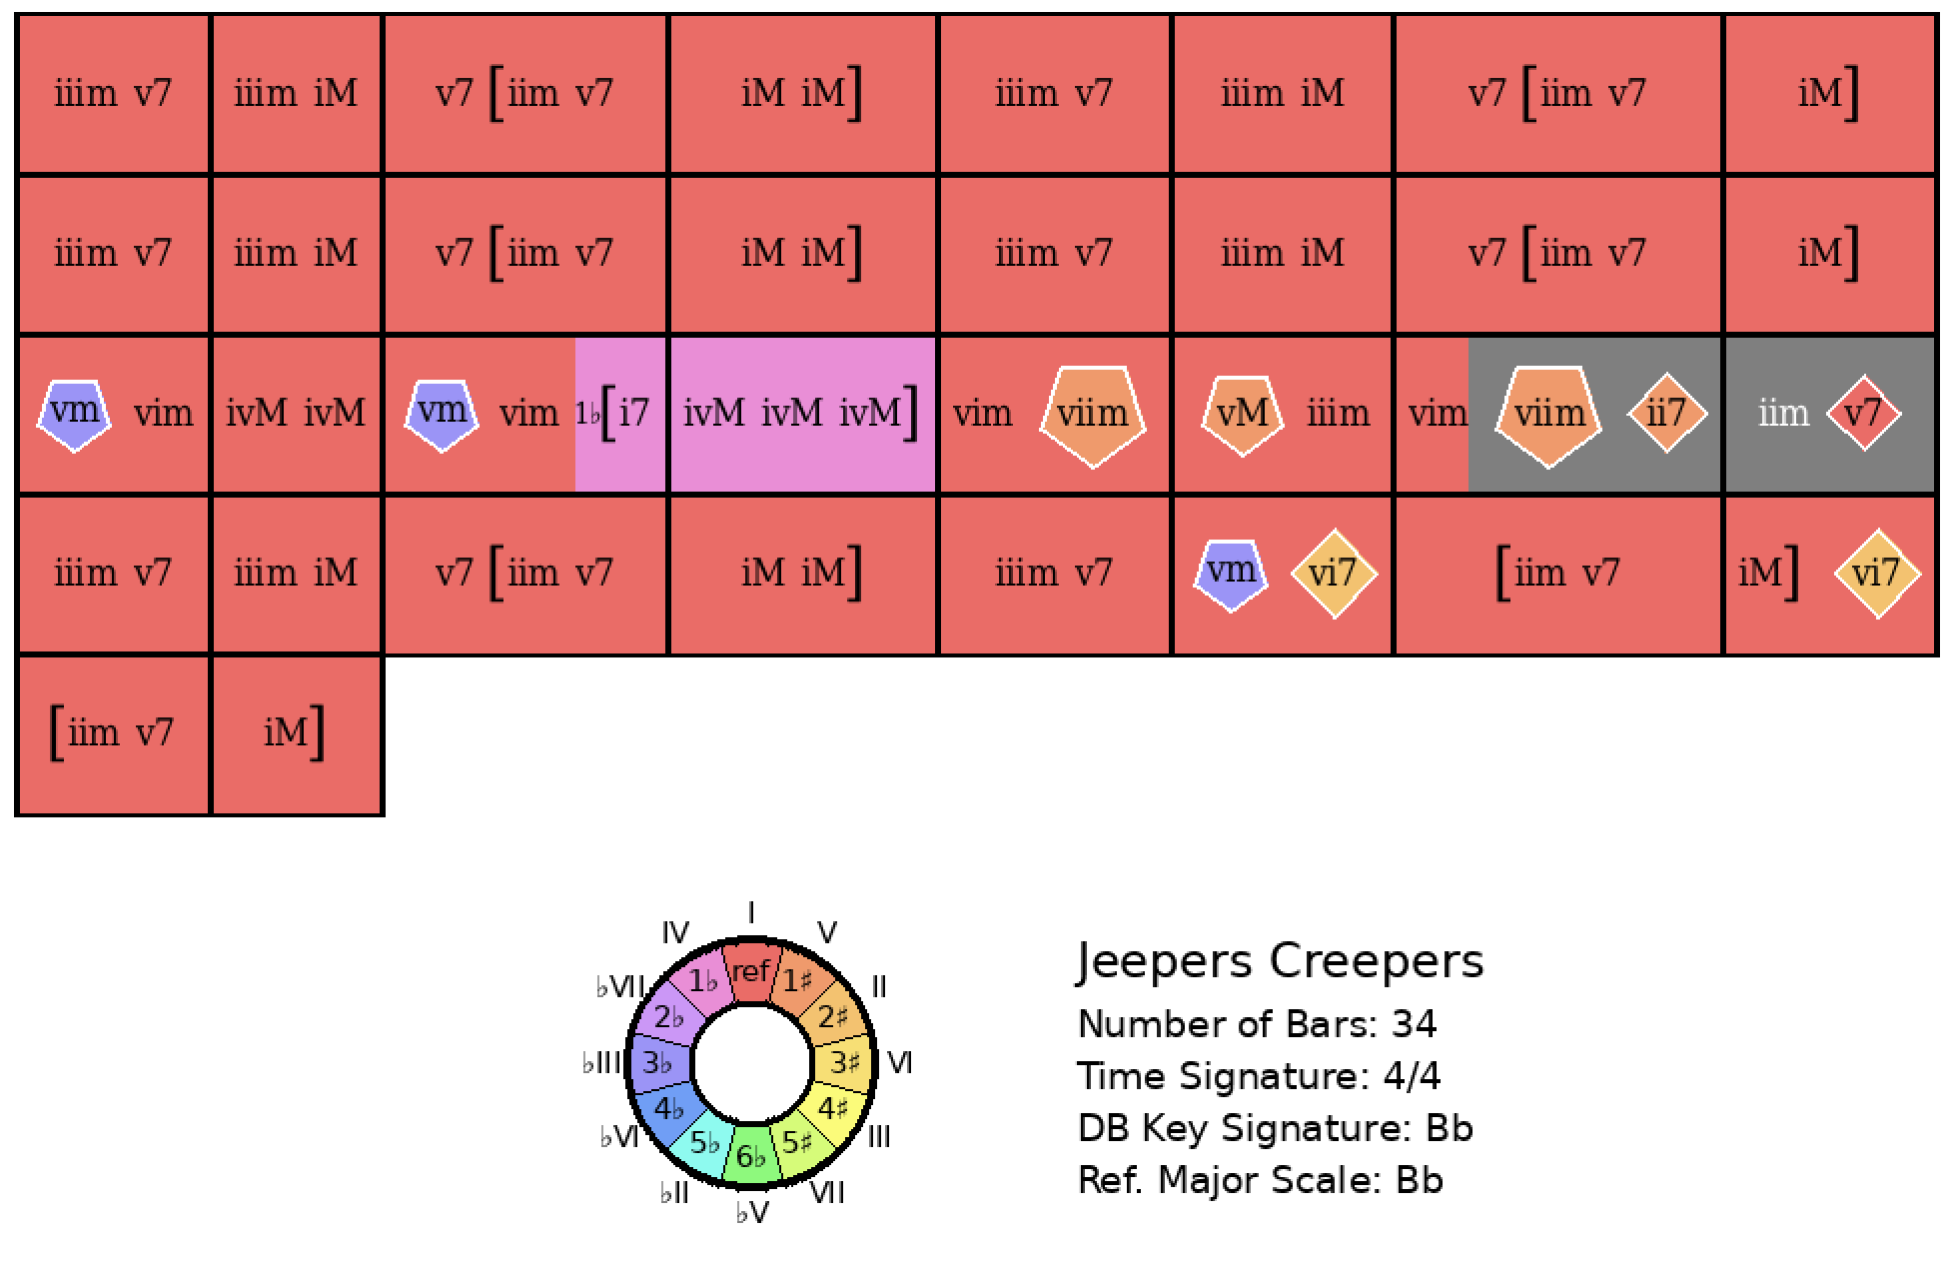
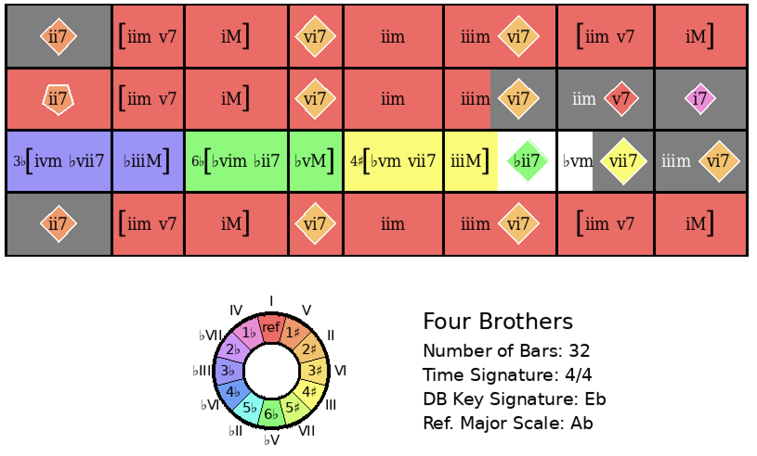
Jeepers Creepers
Rank = 754, Area = 27.90

Slide 26
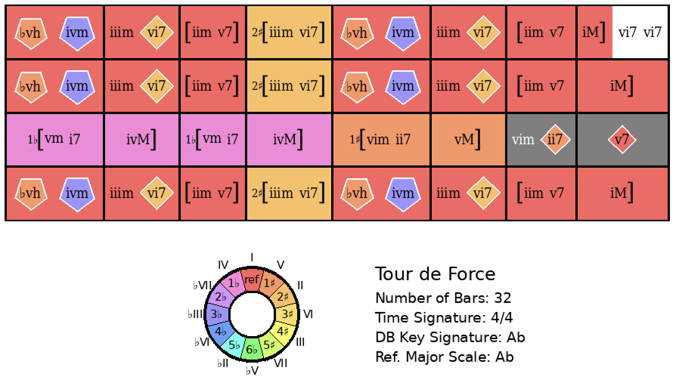
Jeepers Creepers
Rank = 1131 Area = 32.27

Slide 27
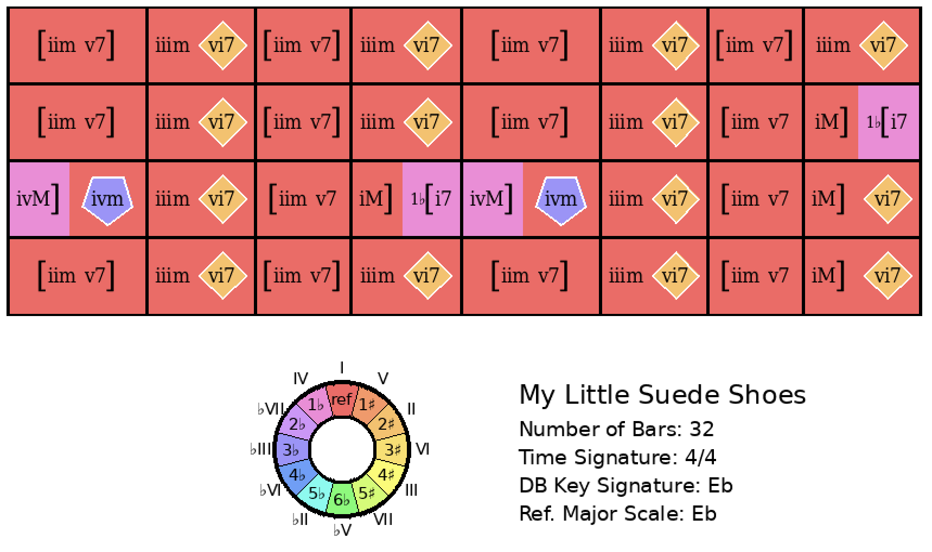
Jeepers Creepers
Rank = 1260, Area = 33.72

Slide 28
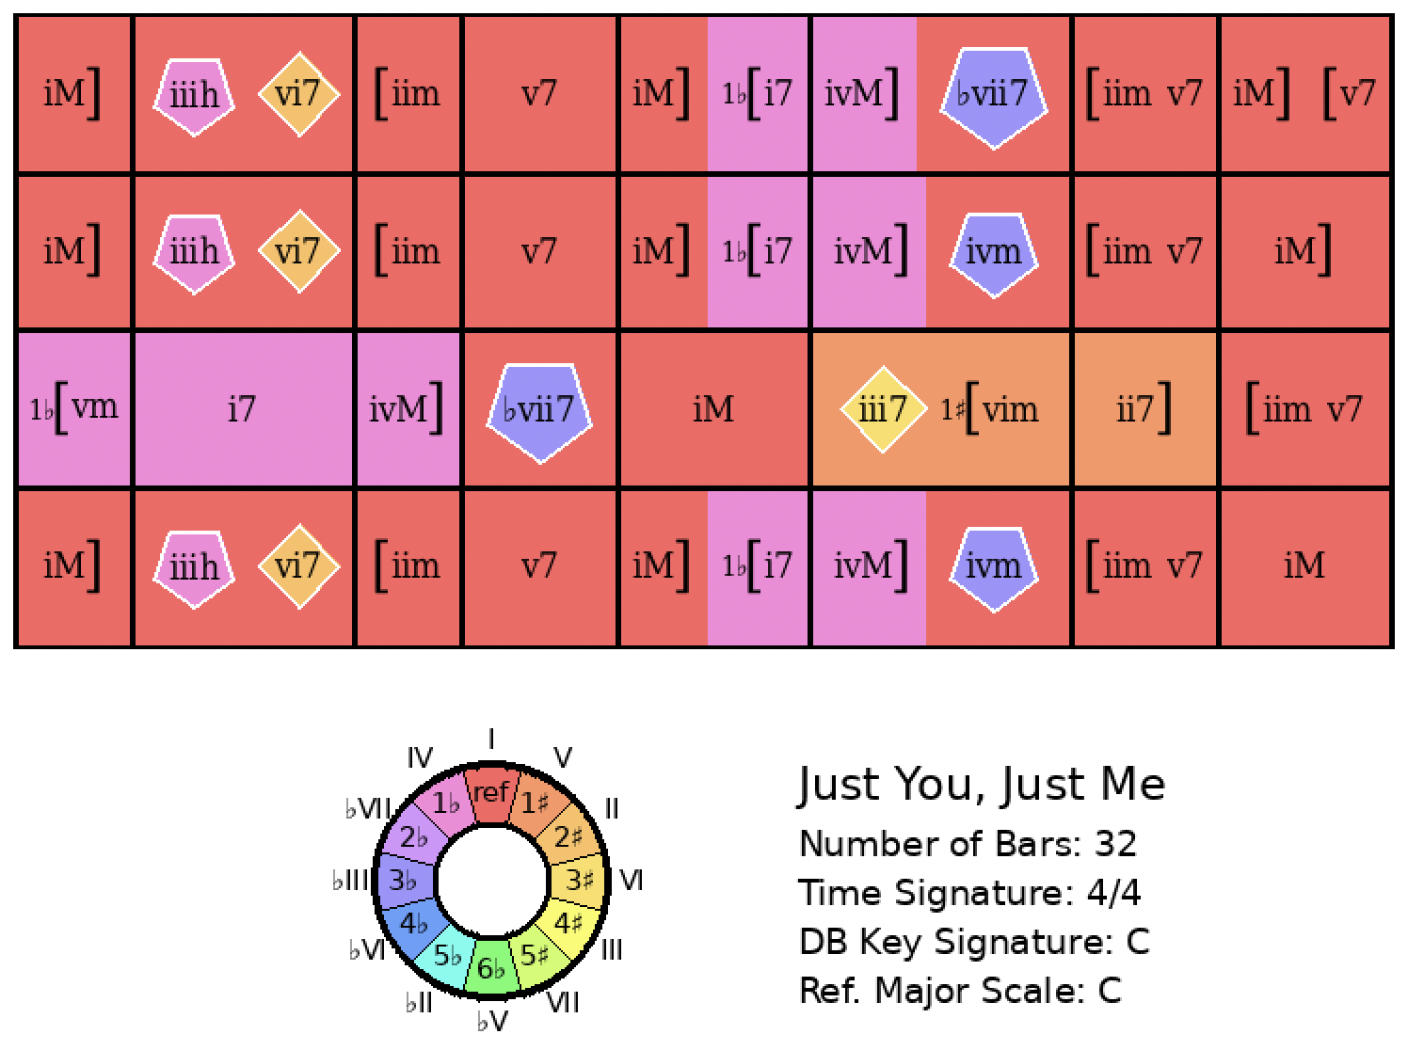
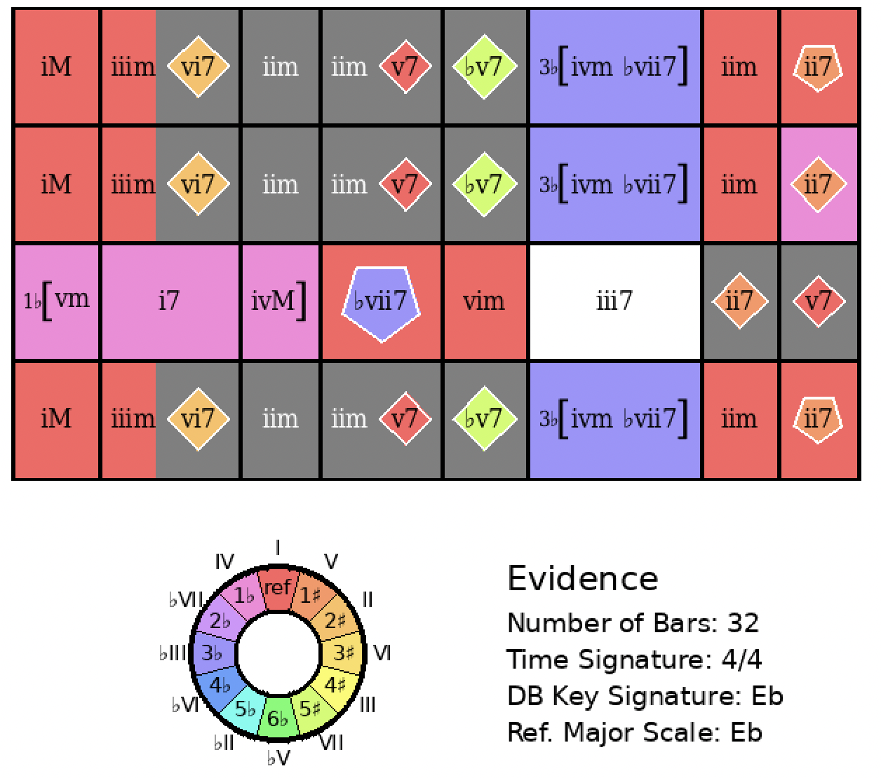
Just You, Just Me
Rank = 354 Area = 22.90

Slide 29
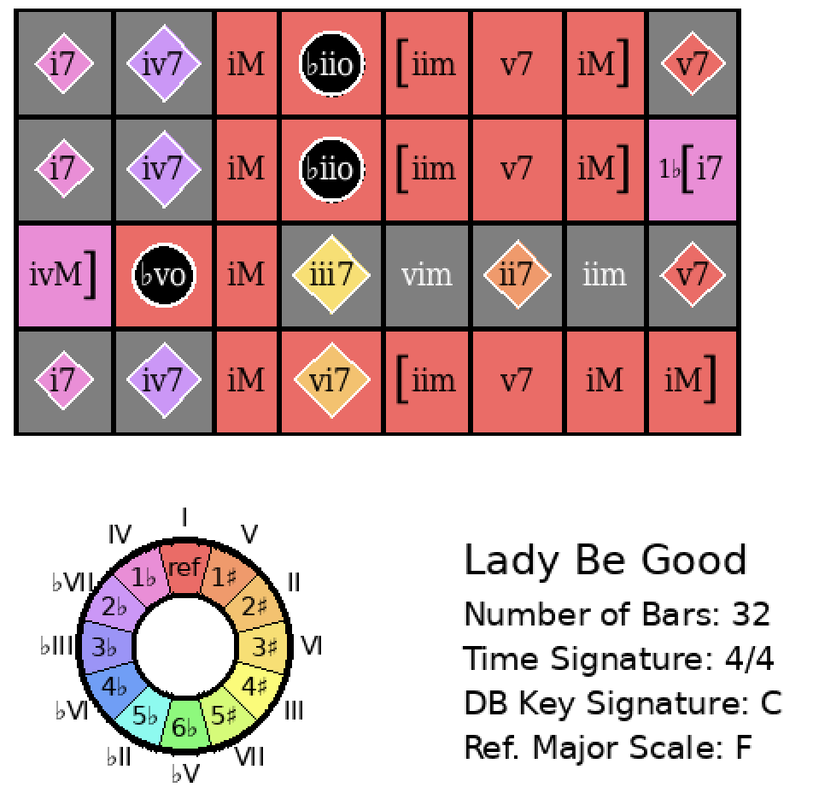
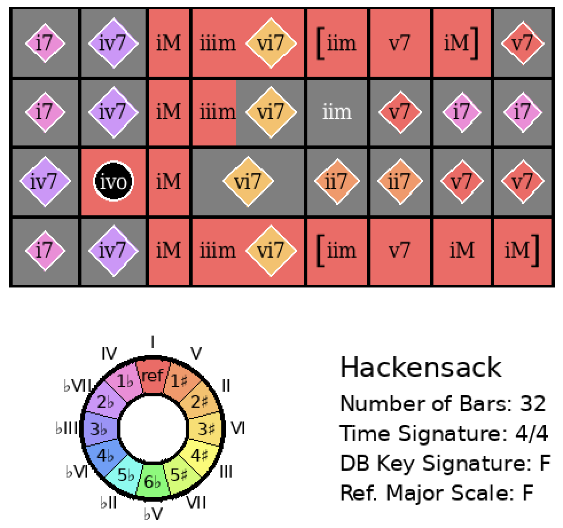
Lady Be Good
Rank = 2, Area = 14.84

Slide 30
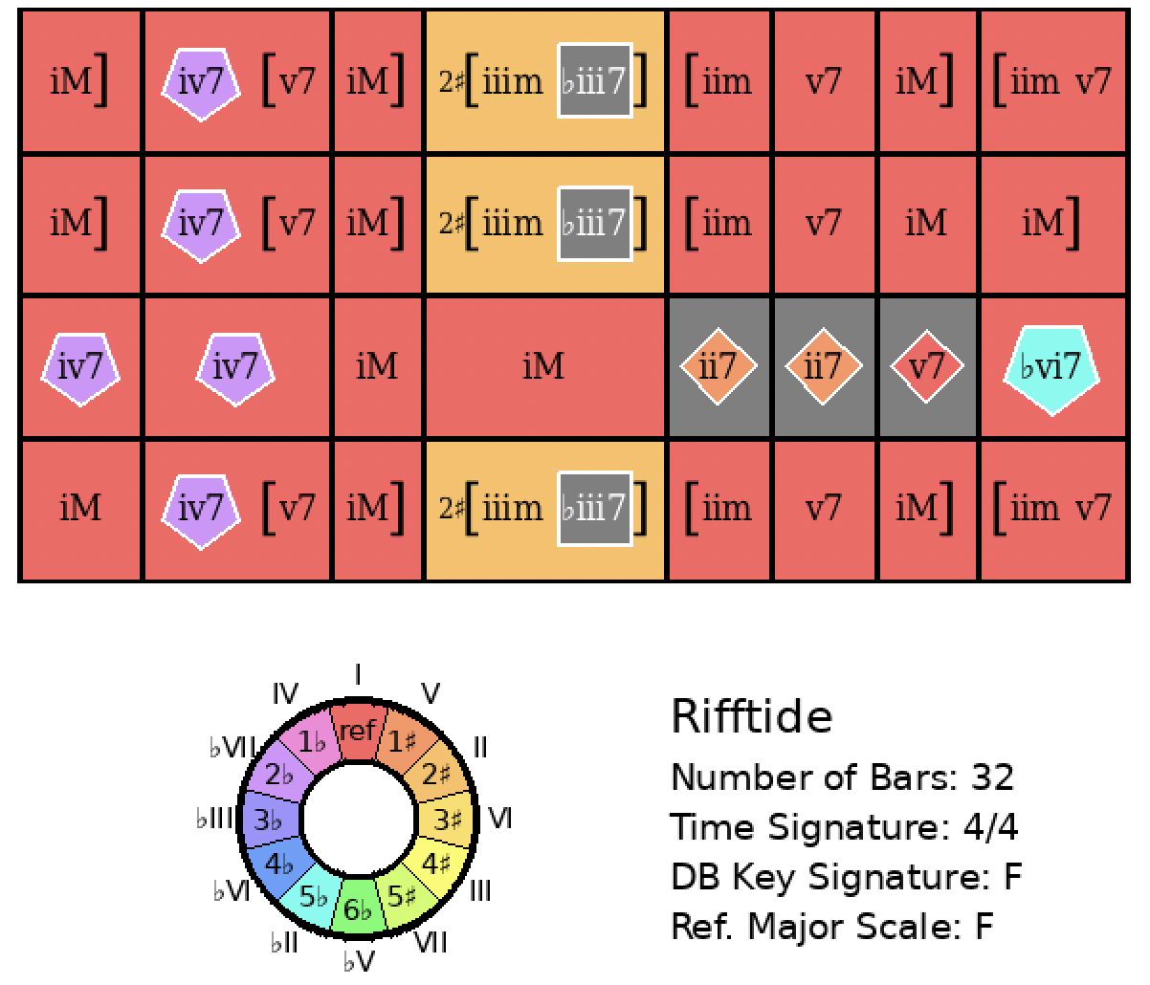
Lady Be Good
Rank = 295, Area = 25.06

Slide 31
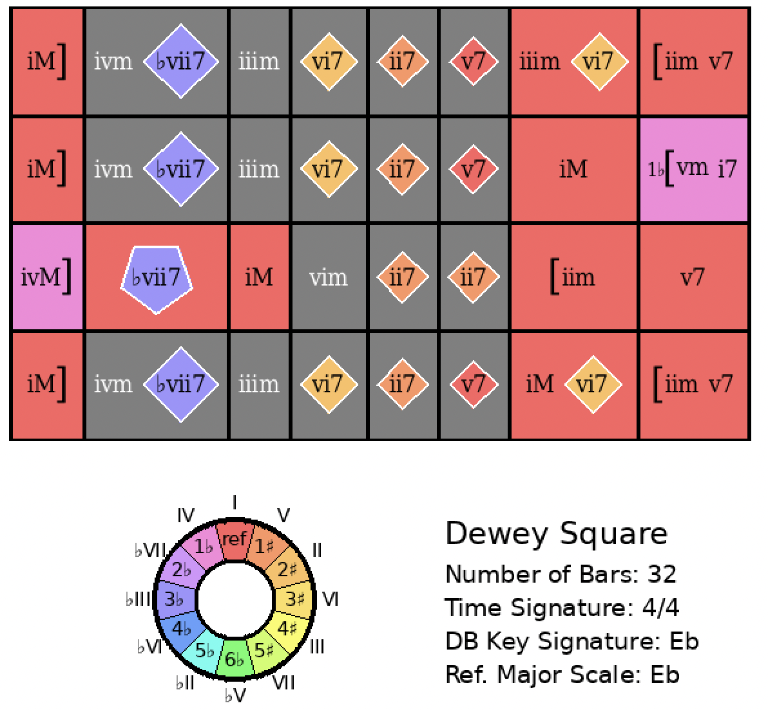
Lady Be Good
Rank = 1527, Area = 39.59

Slide 32
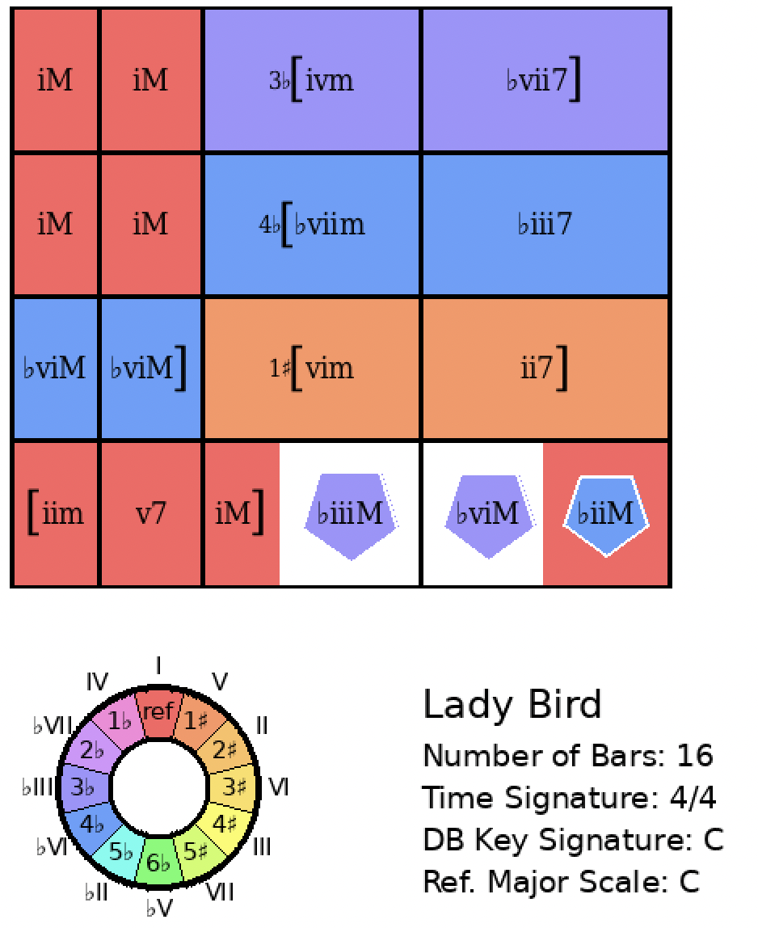

Lady Bird
Rank = 1, Area = 9.68

Slide 33


Love For Sale
Rank = 63, Area = 33.40

Slide 34


Love Me or Leave Me
Rank = 4, Area = 17.15

Slide 35


Lover Come Back to Me
Rank = 2, Area = 12.96

Slide 36


A Night in Tunisia
Rank = 2377, Area = 77.90

Slide 37


On Green Dolphin Street
Rank = 1, Area = 13.72

Slide 38


Out of Nowhere
Rank = 2, Area = 18.36

Slide 39


Pennies From Heaven
Rank = 2476, Area = 70.79

Slide 40


Rose Room
Rank = 1, Area = 10.89

Slide 41


Rosetta
Rank = 2, Area = 16.37

Slide 42


September in the Rain (error on Wikipedia page)
Rank = 1384, Area = 48.26

Slide 43

September in the Rain (proposed correction to Wikipedia page)
Rank = 1, Area = 11.77

Slide 44


So What
Rank = 1, Area = 0.00

Slide 45


The Song Is You
Rank = 85, Area = 24.12

Slide 46


Summertime
Rank = 1803, Area = 82.25

Slide 47


Sweet Georgia Brown
Rank = 1, Area = 5.61

Slide 48

Sweet Georgia Brown
Rank = 2, Area = 10.10

Slide 49

Sweet Georgia Brown (not on Wikipedia page... but interesting)
Rank = 3, Area = 10.19

Slide 50


Tenderly
Rank = 1673, Area = 44.43

Slide 51


Tune Up
Rank = 810, Area = 47.47

Slide 52


Twilight Time
Rank = 87, Area = 25.93

Slide 53


What Is This Thing Called Love?
Rank = 1, Area = 0.00

Slide 54

What Is This Thing Called Love?
Rank = 2401, Area = 73.36

Slide 55

What Is This Thing Called Love?
Rank = 4, Area = 17.44

Slide 56


Whispering
Rank = 1, Area = 12.95

Slide 57


You Can Depend On Me
Rank = 427, Area = 23.53

